Slide 1
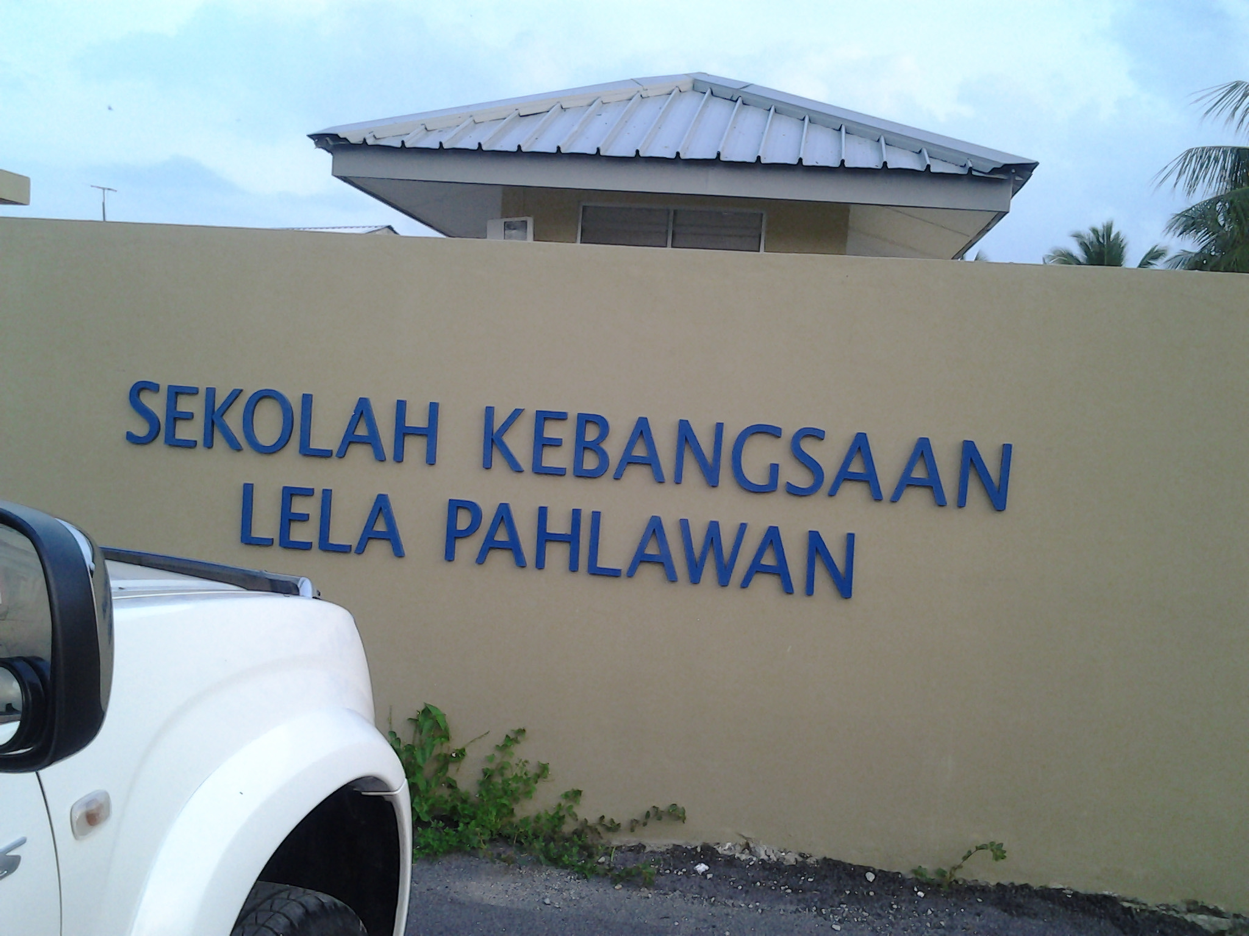
ARE MY CLASS CLEAR AND MOTIVATED? CHECKING AND MAKING SURE.

Slide 2
My Actions:
Taking notes on pupils’ skills and attitudes
Used my action research project
Identified when speaking is possible

Slide 3
4 STRATEGIES EMPLOYED:
Adapt some activities in the book and recycle successful activities to practice other language points later on in a year.
Set pupils tasks where they have to give personalized answers.
Give pupils choices sometimes over games, activities, songs, types of practice.
Practice written work orally beforehand.

Slide 4
1. Adapt some activities in the book and recycle successful activities to practice other language points later on in a year.

Slide 5
2. Set pupils tasks where they have to give personalized answers.

Slide 6
3. Give pupils choices sometimes over games, activities, songs, types of practice.

Slide 7
4. Practice written work orally beforehand.

Slide 8
Group Discussion:
Checking pupils’ understanding
Motivating activities
Observation techniques
Finding chances to speak English

