Slide 1
CHANGING CHILDREN’S PERCEPTION OF READING THROUGH PARENTAL INVOLVEMENT
CYNTHIA C. JAMES (SKK2)
JUSTYNA SKOWRONSKA (ELTDP, BC)
2013

Slide 2
CHILDREN’S READING HABIT
What?
With whom?
THINK!
How do children read at home?
Reading with parents?
Yes? No?
How do they feel about it?

Slide 3
Interview with Year 1 pupils (20 September 2012, SK Kunak 2)

Slide 4
OUR FINDINGS
HOW DO YEAR 1 PUPILS IN SK KUNAK 2 PERCEIVE READING?

Slide 5
For most of the children, ‘reading’ is associated with…
Spelling words
Studying
Doing school work

Slide 6
For the children, reading materials mean:
Text books
Exercise books

Slide 7
The children mostly read…

Slide 8
How do the children feel about reading with their parents?

Slide 9
Reading is supposed to be fun.

Slide 10
What did the parents say?
Interview with Level 1 parents, SKK2
(September 20, 2012)

Slide 11
Changing Children’s Perception of Reading through Parental Involvement
Initial Perception of Reading
Reading for Pleasure
Parental Involvement
Intervention
New Perception of Reading

Slide 12
READING FOR PLEASURE
Why is it important?
“Every man who knows how to read has it in his power to magnify himself, to multiply the ways in which he exists, to make his life full, significant and interesting.”
~Aldous Huxley

Slide 13
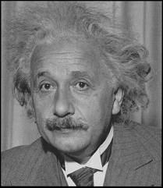
‘Reading for Pleasure’
What does it mean to you?
How important is ‘reading for pleasure’ to children?
“If you want your children to be intelligent, read them fairy tales. If you want them to be more intelligent, read them more fairy tales.” ― Albert Einstein

Slide 14
Definition
“…reading that we do of our own free will anticipating the satisfaction that we will get from the act of reading. It also refers to reading that having begun at someone else’s request we continue because we are interested in it.”
(Clark & Rumbold, 2006).

Slide 15
When children get ‘hooked on books’, they will…
…become adequate readers.
…acquire a large vocabulary
…develop the ability to understand and use complex grammatical constructions.
…develop a good writing style.
…become good spellers.
(Krashen, 1993)

Slide 16
“Although free voluntary reading alone will not ensure attainment of the highest levels of literacy, it will at least ensure an acceptable level. Without it, I suspect that children simply do not have a chance.”
(Krashen, 1993)

Slide 17
Parental Involvement
Why is it important?
“Children are made readers on the laps of their parents.”
~ Emilie Buchwald

Slide 18
Parents of SKK2 pupils
Involvement in school activities:
Average income:
Education level:
PIBG Meeting
RM350 – RM600 per month
College/University: 2%
Sports and Games
Upper secondary: 40%
Social Gatherings
Lower secondary: 48%
Source: Students’ Affairs Unit (Unit HEM),
SK Kunak 2 (based on school’s data in November 2012)
Primary: 10%

Slide 19
How important is family involvement?
…whose mothers have less education.
Matters most for children…
…who come from low-income families.
Even one or two additional involvement activities per year were associated with meaningful improvements for children.
How often?
(Research findings cited by Clark,
Why Families Matter to Reading, 2007)

Slide 20
LearnEnglish Family (LEF) Workshops in SKK2
Parental Involvement in Reading

Slide 21
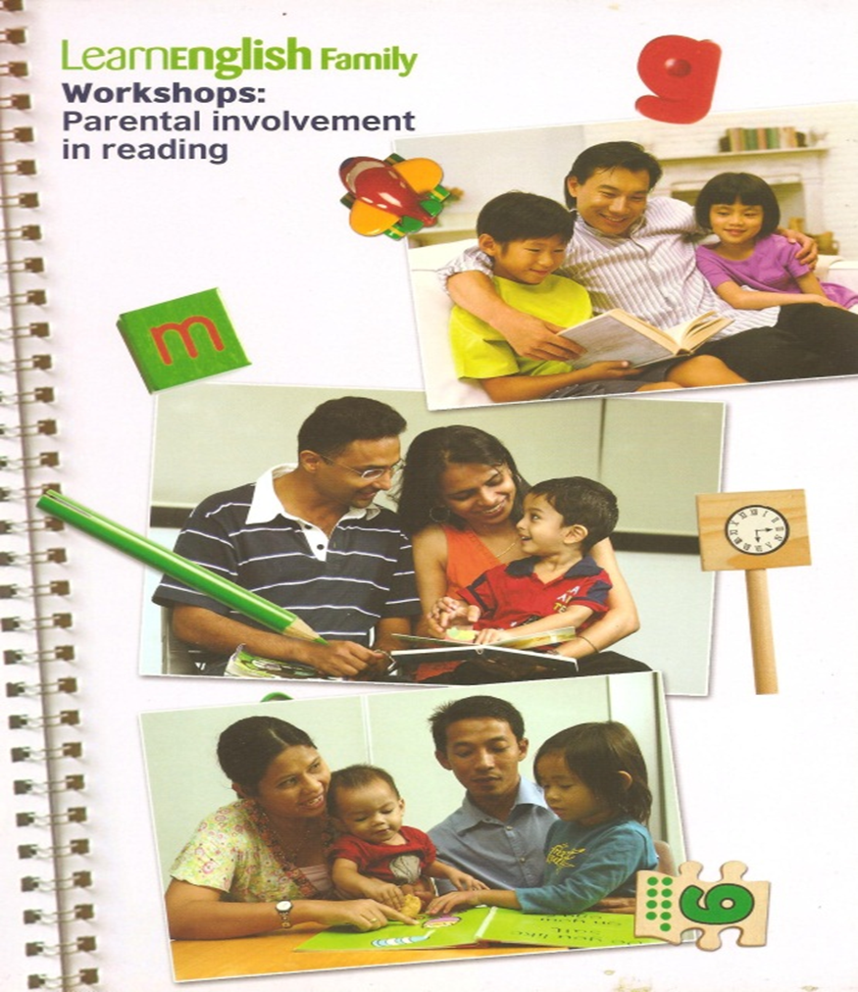
LEF Handbook

Slide 22
Objectives
To instill the love of reading in children through parental involvement
To introduce the concept of ‘reading for pleasure’, both to parents and children
To encourage collaboration and partnership between teachers and parents
To improve children’s literacy skills through fun and interesting reading activities

Slide 23
How?
Parents Meeting – to introduce LEF Workshops to parents
Workshop 1: Sharing Rhymes
Workshop 2: Sharing Stories

Slide 24
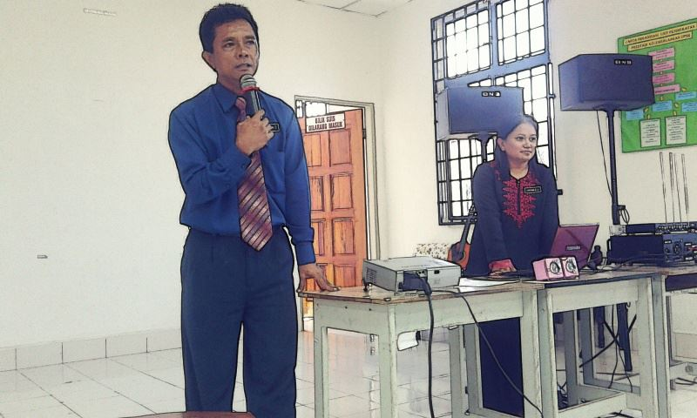
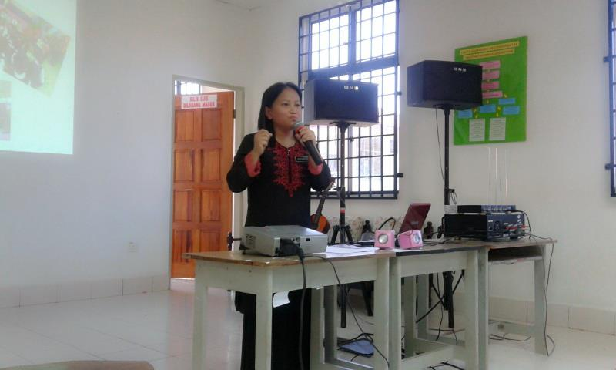
Parents Meeting
September 21, 2012
Introducing LearnEnglish Family (LEF) Workshops to the parents.

Slide 25
Workshop 1: Sharing Rhymes
September 28, 2012
Introduction to rhymes and how it can be done with children at home.
Parents tried out the activities in small groups.
Homework for the parents: ‘Share a rhyme with your child at home and share your experience in the next workshop.’
Handout 1
Handout 2

Slide 26
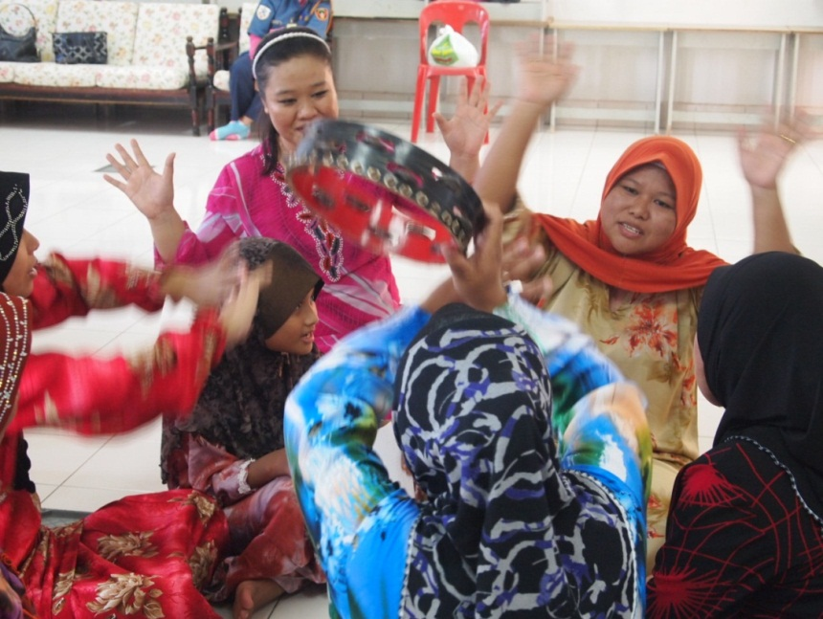
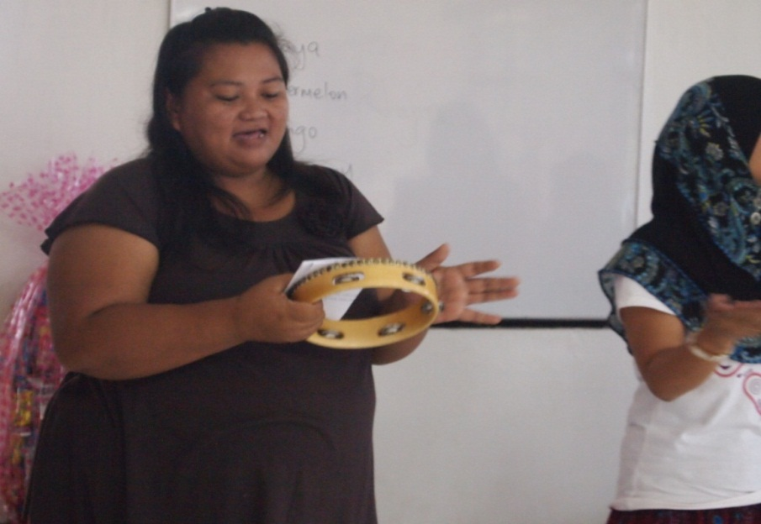
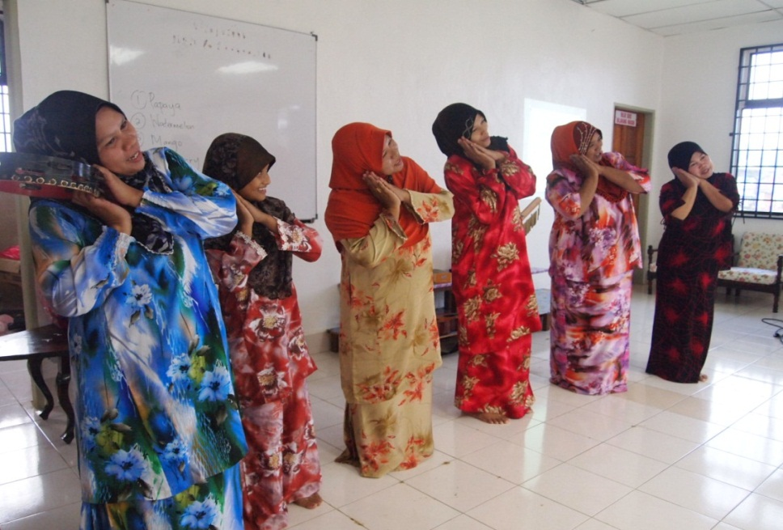

Slide 27
Workshop 2 – Sharing Stories
October 16, 2012
Story-telling demonstration – how it can be done with children at home.
Story-telling group task for parents.
Homework for parents: ‘Tell a story to your child at home and share your experience in the next workshop.’
Handout 1
Handout 2

Slide 28
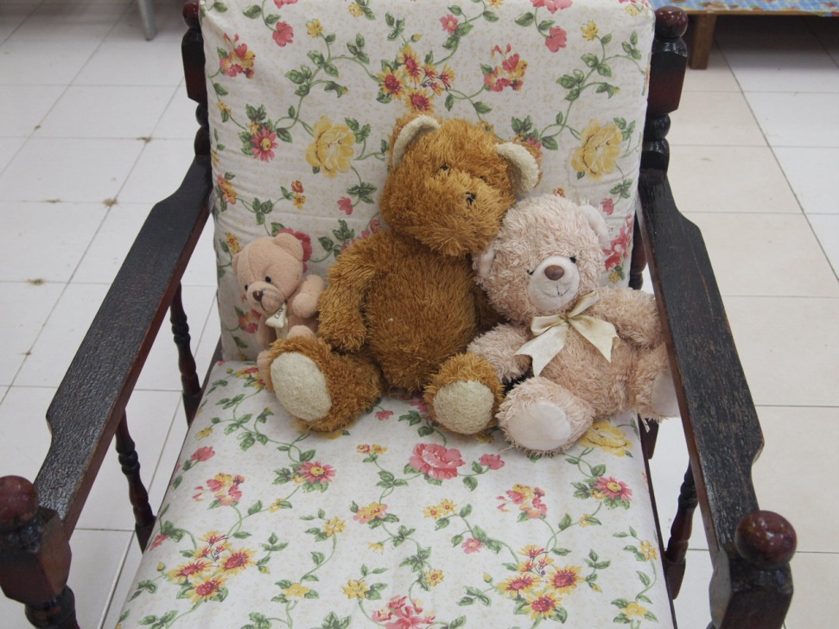
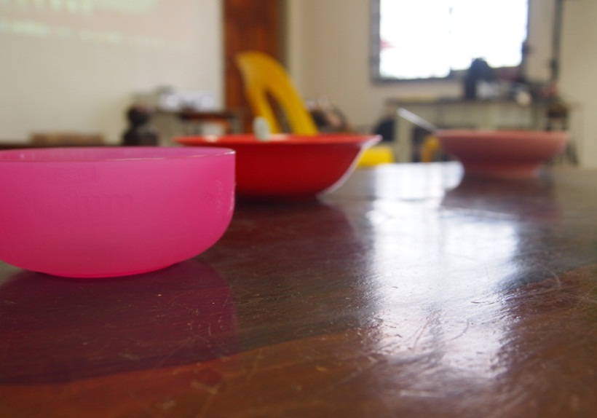
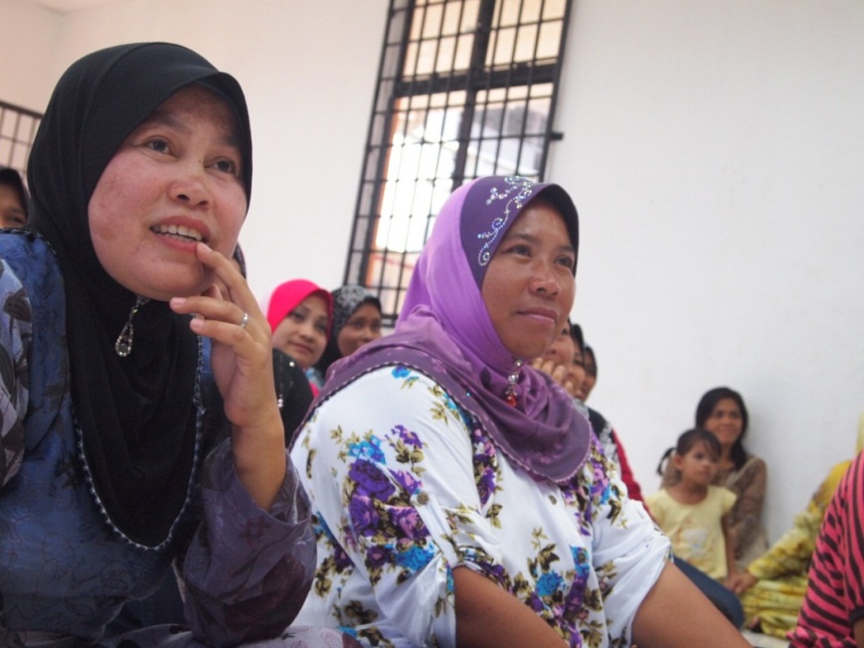
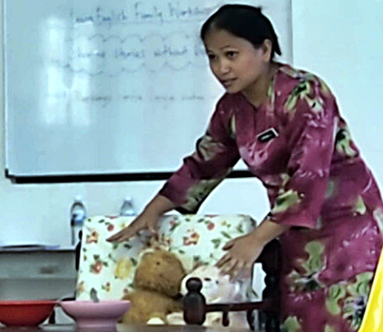

Slide 29
LEF Workshops in SK Kunak 2 (2012)

Slide 30
PARENTS’ FEEDBACK
What did they think about the workshops?

Slide 31
Parents’ Feedback on the Workshops

Slide 32
What’s next?
Workshop 3: Sharing stories with picture books
Workshop 4: Making resources – story sacks
Workshop 5: Helping children choose books
Workshop 6: Creating a suitable reading environment

Slide 33
IMPACT OF THE WORKSHOPS ON THE CHILDREN
Did the workshops change the children’s perception of reading?

Slide 34
Interview with Year 1 pupils
(23 & 24 October 2012, SK Kunak 2)

Slide 35
What do you think?
Do you notice any change in the way the children perceive reading?
What is different this time?

Slide 36
A mother’s story…
“LEF workshops have changed the way I bond with my son.”
(31 January 2013, SK Kunak 2)

Slide 37
“You may have tangible wealth untold.
Caskets of jewels and coffers of gold. Richer than I you can never be –
I had a mother who read to me.“
~ Strickland Gillilan

Slide 38
A FEW FINAL QUESTIONS…
How early should we conduct these interventions?
Should we start in Year 1 or earlier?
Should we wait until the children are a bit older?

Slide 39
What does ‘reading’ mean to Year 4 pupils of SKK2?
Interview with Year 4 pupils
(7 November 2012, SK Kunak 2)

Slide 40
“There is more treasure in books than in all the pirate's loot on Treasure Island.”
~ Walt Disney
From ‘Mr. Fitz Comic Strip’ by David Lee Finkle
Facebook: Mr. Fitz Comic Strip
Website: http://www.mrfitz.com/

Slide 41
REFLECTION
Looking back…

Slide 42
Solutions to problems
Obstacles
Before
During
Doubts
Looking back…
Discovery
After
How did I feel?
What did I learn?

Slide 43
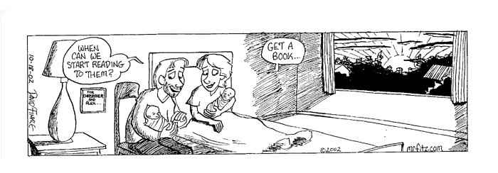
It’s never too early…
"There are many little ways to enlarge your child's world. Love of books is the best of all."
~ Jacqueline Kennedy
From ‘Mr. Fitz Comic Strip’ by David Lee Finkle
Facebook: Mr. Fitz Comic Strip
Website: http://www.mrfitz.com/

Slide 44
References
British Council. (2012). LearnEnglish Family Workshops: Parental Involvement in Reading. British Council.
Clark, C. (2007). Why Families Matter to Literacy - A Brief Research Summary. London: National Literacy Trust.
Clark, C., & Rumbold, K. (2006). Reading for Pleasure: A Research Overview. National Literacy Trust.
Close, R. (2001). Parental Involvement and Literacy Achievement. London: National Literacy Trust.
Krashen, S. (1993). The Power of Reading. Englewood, Col.: Libraries Unlimited, Inc.
National Union for Teachers (NUT). (n.d.). Reading 4 Pleasure. United Kingdom: National Union for Teachers (NUT).

Slide 45
List of websites
Researches on Literacy:
http://www.literacytrust.org.uk/
Rhymes and stories:
http://learnenglishkids.britishcouncil.org
Comic strips by Mr. David Lee Finkle:
http://www.mrfitz.com/
Facebook: Mr. Fitz Comic Strip

