Slide 1
BUDDY READING (For Level One Students) SK South, Miri
Compiled by:
MARIANA SIM
2013

Slide 2
DEVELOPING STUDENTS’ INTEREST IN READING ENGLISH STORY BOOKS THROUGH BUDDY READING. (FOR LEVEL ONE STUDENTS)

Slide 3
IMPLEMENTATION
Level : Year 2, Year 6 (2012)
Year 1, 3 and 5 (2013)
Time : 60 minutes a week during English period
Duration : 17 months
Venue : Library

Slide 4
Stage 1 (July, 2012 – November, 2012)
Involve Year 6 students in planning for reading with younger students.
Select interesting books to cater for the needs and ability of the Year 2 students.
Give Year 6 students the opportunity for a role-play before working with younger students.

Slide 5
Stage 2 (January – November, 2013)
Extend the programme to two classes of different age levels.
Year 5 reading to Year 3
Year 3 reading to Year 1

Slide 6
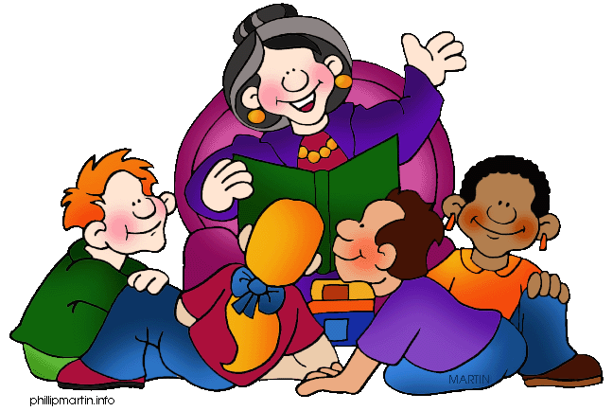
BIG BUDDIES
Big Buddies chosen by the teacher were asked to attend a mini workshop in early January. This session was conducted in the morning (during the Library period). The teacher selected from among students those with certain abilities or qualities : Students who can read well, have a clear voice and who are eager to participate. The teacher must explain to Big Buddies that they are role models as well as big buddies.

Slide 7
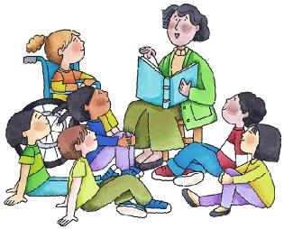
LITTLE BUDDIES
The teacher gives briefing in the class during English period in early January on the following things :
Start with a discussion on the buddy reading.
Tell them that they are going to have Big Buddies reading to them every week for one hour.
Talk about behavioural expectations.

Slide 8
IMPLEMENTATION STEPS OF BUDDY READING FOR A PARTICULAR WEEK
Meeting between Big Buddies and Little Buddies a week before the programme begins in the library for about 20 minutes, during Friday recess (getting to know each other).
Students sit on the floor.
Teacher creates a list of little buddies, pairing that could work well together.
Paired reading for the weaker students and 3 or 4 Little Buddies in a group for the average and the good ones.
Allocate the buddies to their respective places in the library for the coming week programme.
Select books that they like to read. (allow the buddies to choose their own books).

Slide 9
ON THE DAY ITSELF
Big Buddies invite the little buddies from their class to the library five minutes earlier before the programme begins.
Big Buddies get the books that they chose at the teacher’s table.
Buddy reading session lasts for 20 to 30 minutes (Level 1 students normally have shorter attention span).
Little Buddies and Big Buddies are allowed to read books of their own choice for about 10 – 15 minutes (free reading).
The buddies are asked to sit on the floor.
The teacher asks for feedback / reflection from the Buddies by asking questions. (10 minutes)

Slide 10
WHY BUDDY READING CAN BE A SUCCESS
It is something different and does not focus on the teacher but on student-student learning.
Students can pick books of their own choice. This encourages their positive participation.
Students can find it more enjoyable to read to each other rather than chanting a text aloud as a class.
Students enjoy reading with their peer groups.

Slide 11
IMPACT ON THE STUDENTS THROUGH BUDDY READING
Students are showing greater interest in reading.
Their self-confidence is increasing.
Command of the language is improving.
They are participating actively in the programme and look forward to it each week.
They are able to pronounce common words with greater accuracy.
Their English vocabulary is increasing.
Stimulate imagination (through the books that they read).
The programme has produced some observable changes in shy students. They come out of their shells and are smiling, talking and participating in class activities and are interactive and socialise more with their friends.
Big Buddies gain more confidence in themselves.
Big Budies also learn to be more responsible and acquire greater fluency.

Slide 13
Melentur buluh biarlah dari rebungnya.

