Slide 1
ENGLISH LANGUAGE CENTRE
SK RANGGU, TAWAU,
SABAH.

Slide 2
INTRODUCTION
The English Language Centre is not just about learning English – important as that is – it is about learning from each other, teacher to students, student to student and student to teacher.
This special room is for English Language. It is important for the teaching and learning process to take place in an environment which is comfortable and conducive.

Slide 3
OBJECTIVES
English Language can be taught in creative and innovative ways with a variety of methods
For our pupils to like English Language more than before
To gain confidence and fluency for speaking English.
To develop our students understanding and knowledge of the English Language
The place where teachers can display students’ work

Slide 4
THE BUDGET
From teachers
From a bookshop
From the school
From mentors

Slide 5
WHAT KIND OF ACTIVITIES.
Group activity
Singing
Making puppets
Making big book and pop up books
Story telling
Using the interactive CD
Playing scrabble, puzzle and
quiz
Reading books

Slide 6
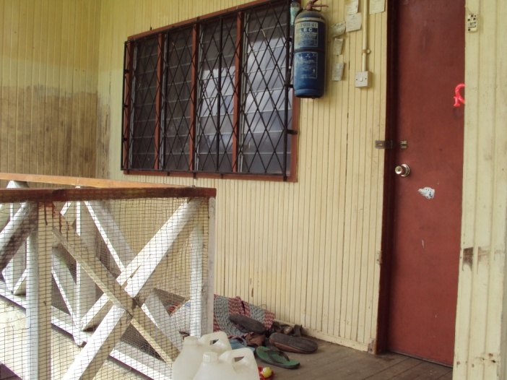
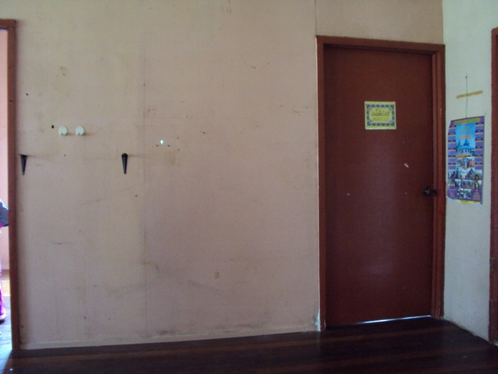
EMPTY TEACHER HOUSE (BEFORE)

Slide 7
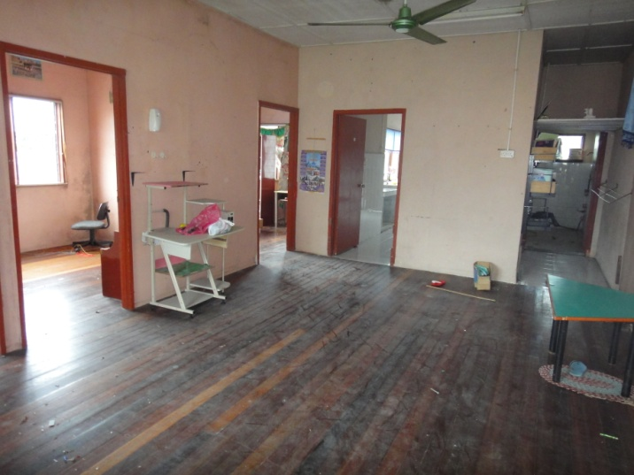
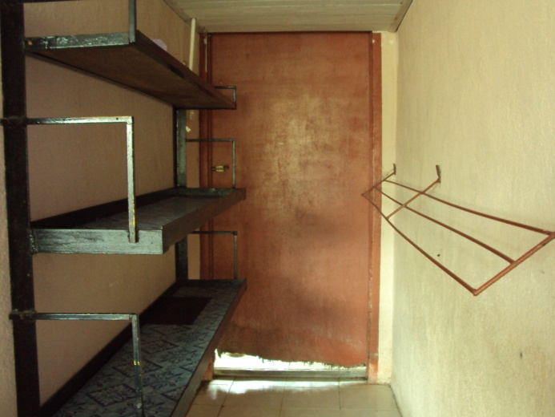

Slide 8
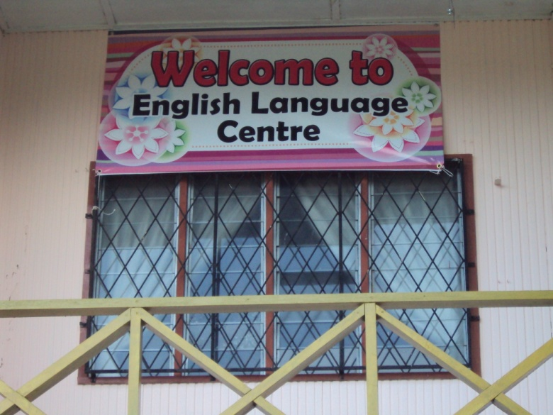
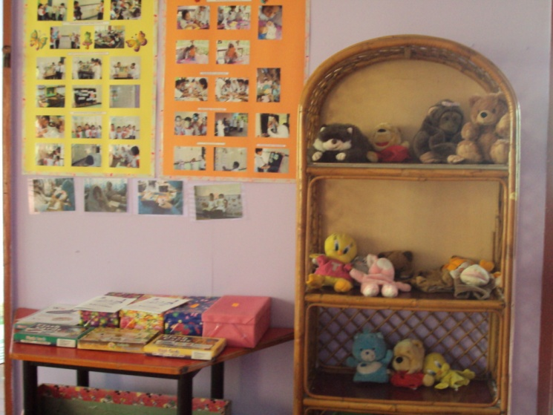
AFTER

Slide 9
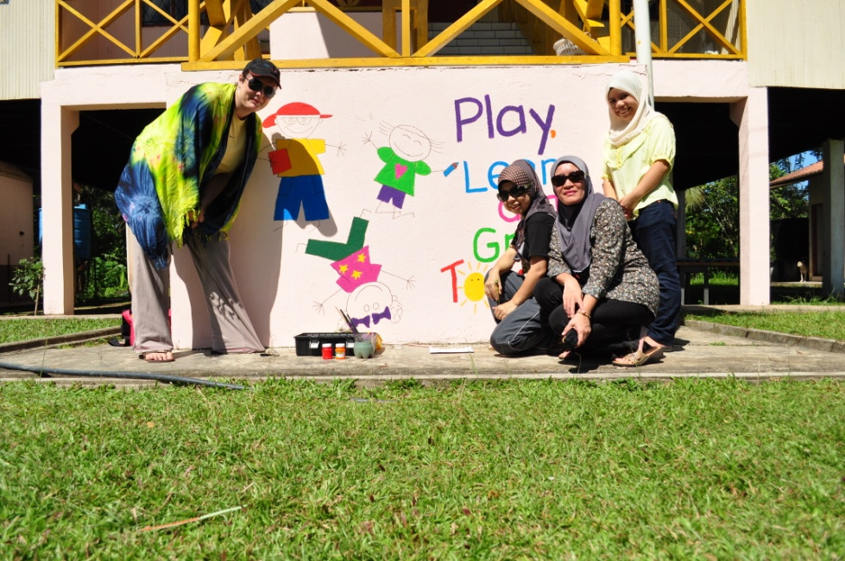
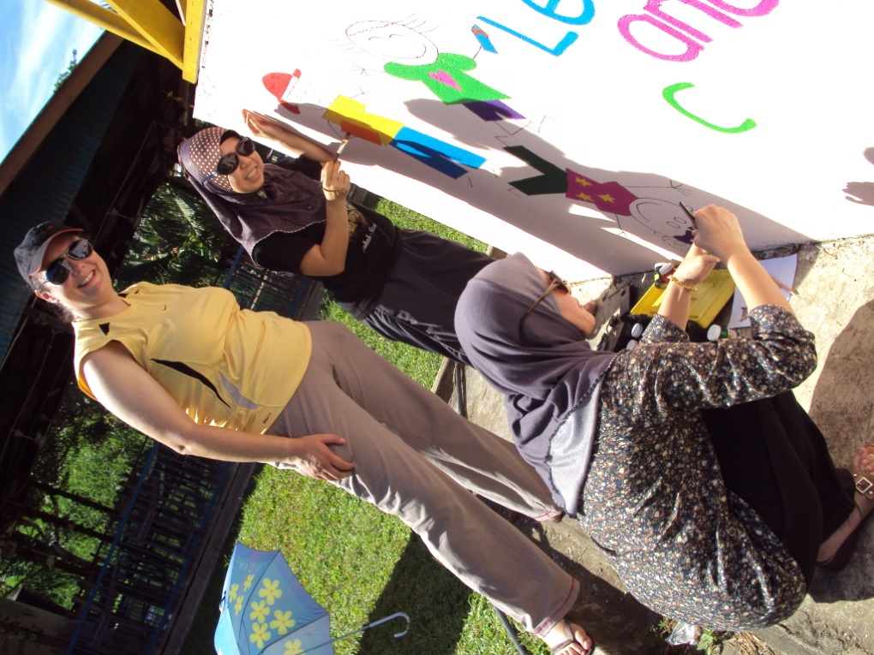
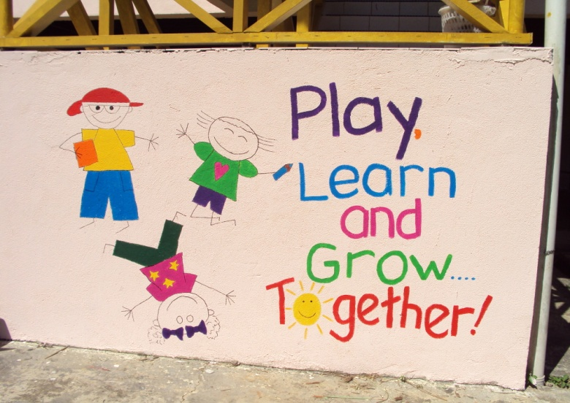

Slide 10
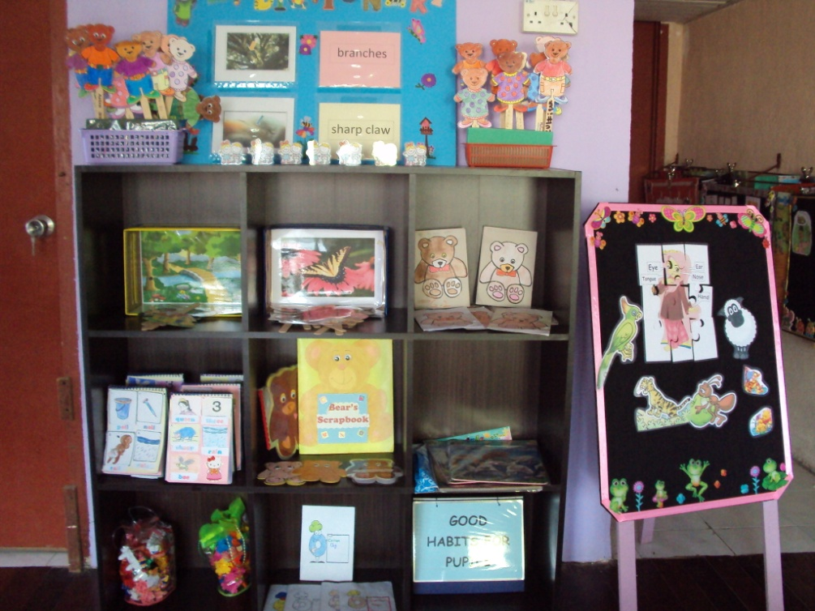
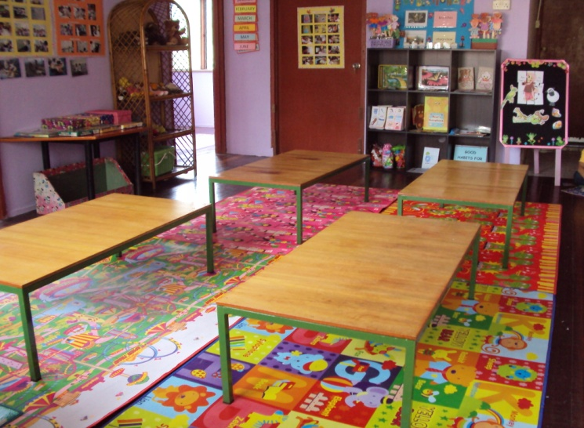

Slide 11
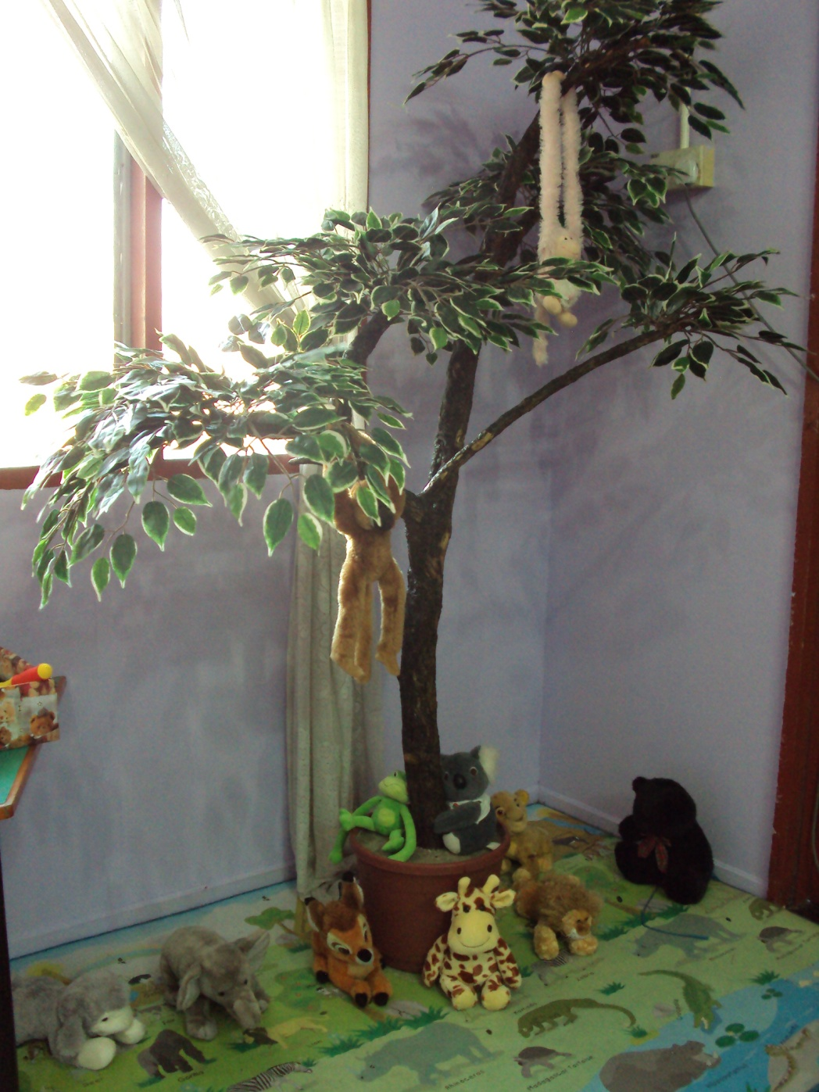
The Jungle Corner

Slide 12
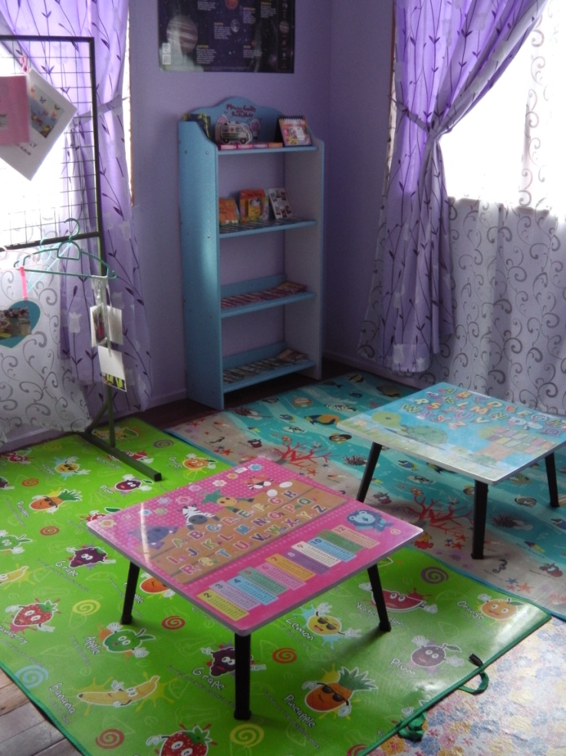
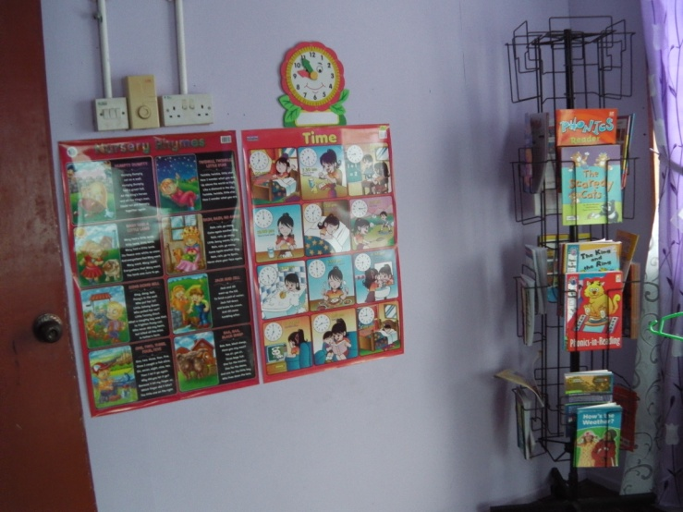
MINI LIBRARY

Slide 13
Materials needed:
Table
Cupboard
Mat
Books
Book rack
Fan
Radio
Screen
Puppets
Things necessary

Slide 14
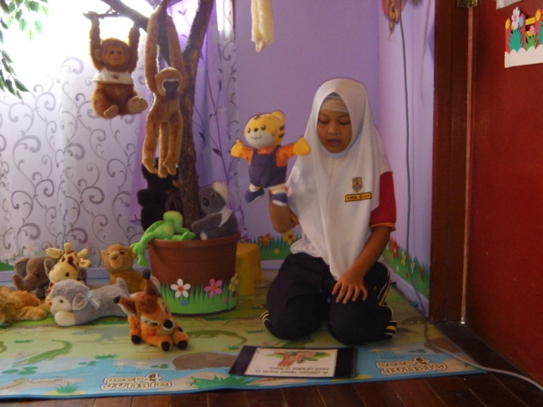
ACTIVITIES

Slide 15
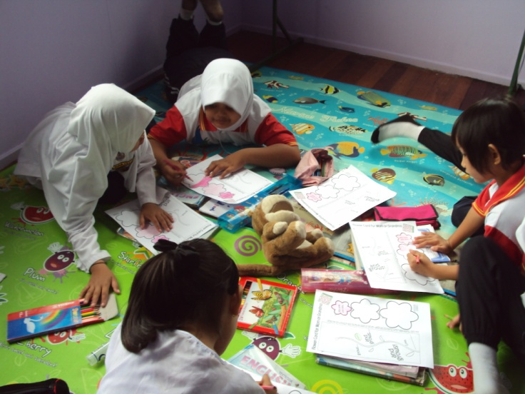
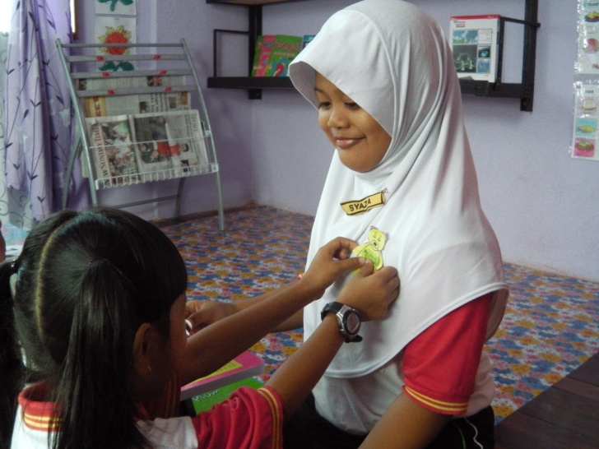

Slide 16
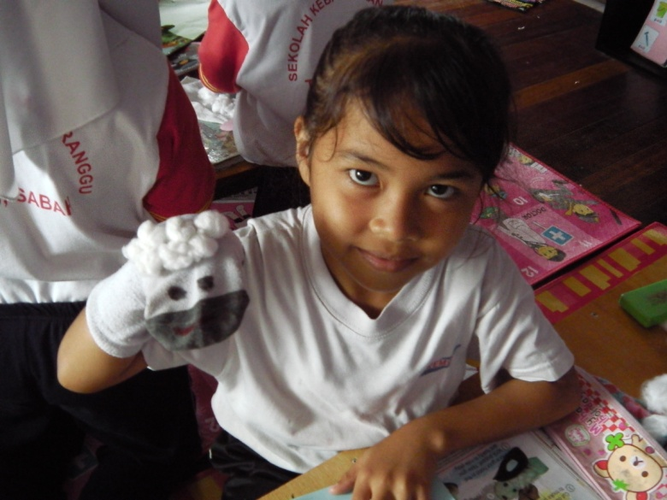
ACTIVITIES

Slide 17
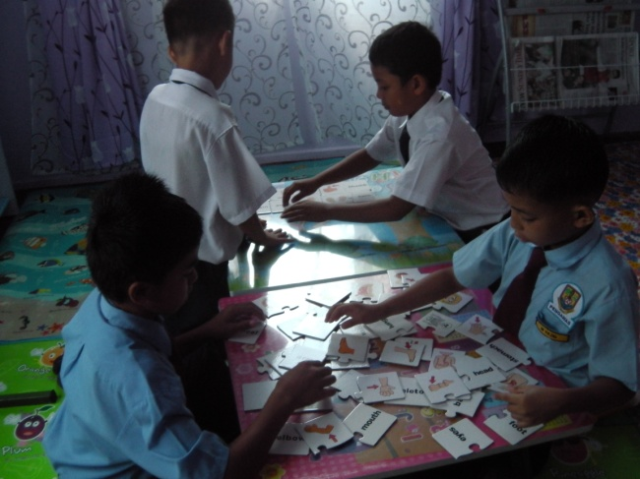
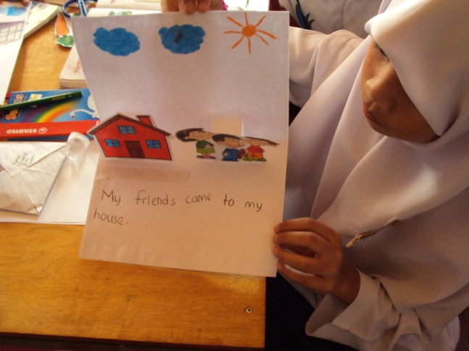

Slide 18
ELC Opening Ceremony.
Preparation before the opening ceremony.

Slide 21
The Day of the Opening Ceremony.

Slide 28
GROUP WORK
Think what can you do in your school?

Slide 29
THANK YOU

