Slide 1
My Journey with my Year 2 Amanah, English class
Morinie Linus ELDTP Symposium
February 2013

Slide 2
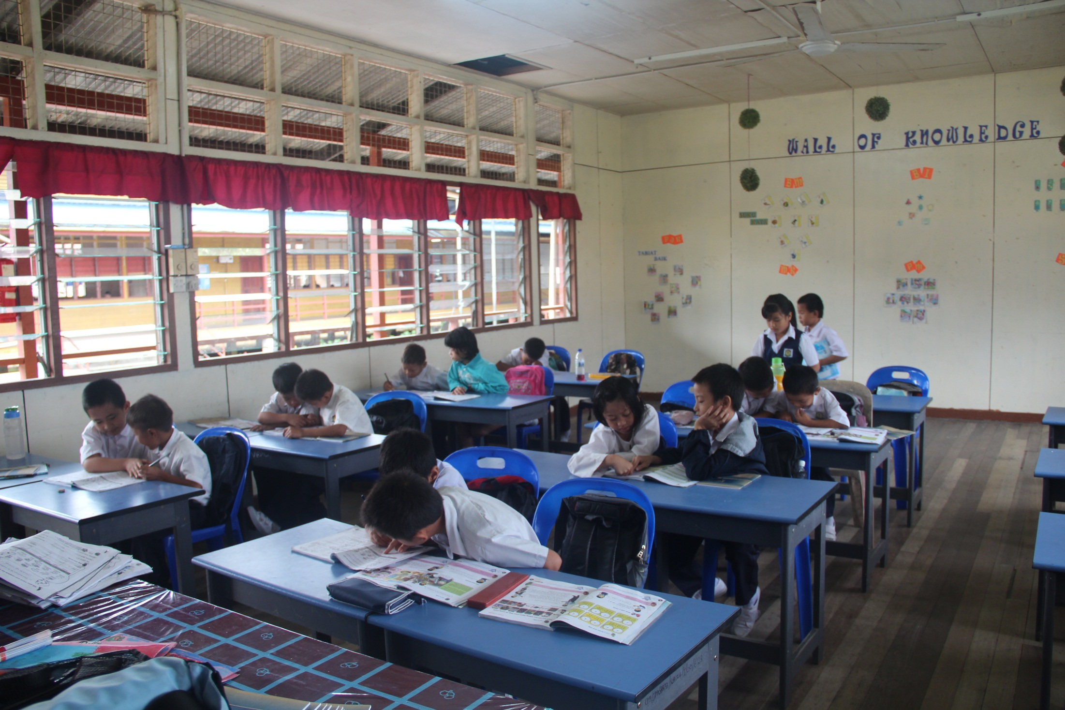
Notes:
They look well behaved and hard working now .. but yesterday was a different story…..

Slide 3
What I inherited:
An apparently unteachable class with severe behavioural problems
And Special Needs

Slide 4
Running out of the classroom
Jumping on chairs and tables
Ripping up school books
Destroying people’s property
Fighting
That was Amanah….

Slide 5
Then I started to change things….

Slide 6
I used a teacher – centred approach to keep control of my class
I broke up friendship groups, used seating plans
And introduced a monitor for each table to monitor group behaviour
I also used a reward system when they worked hard and behaved well.

Slide 7
After a couple of months, I had the class under control but I felt they lacked motivation. The Year 2 KSSR textbook lacked lustre and wasn’t designed for pupils with learning difficulties and so I STOPPED RELYING ON THE TEXTBOOK.
So I started asking the pupils what they wanted to do in the lesson.
Based on their feedback, I created tasks that were in line with the KSSR Learning Standards/ DOCUMENT STANDARD
And I followed what area of phonics was being
taught that week .

Slide 8
The Learner-Centred Curriculum takes as its starting point what is done by language teachers in their classes. Nunan develops a concept of the negotiated model in which the curriculum is a collaboration between teachers and students.
“A person cannot teach another person directly; a person can only facilitate another's learning” (Rogers, 1951).

Slide 9
This led me to try Task-based Learning (TBL)

Slide 10
Instead, having given the pupils a choice, they were intrinsically motivated and engaged in the task and learnt authentic English from doing the task.
The language is sought by the pupil in a bid to complete the task.
The teacher as facilitator supplies the language.
In TBL, the language is not pre-selected but rather drawn from the learner to meet the demands of the task.
Motivation for communication becomes the primary driving force.

Slide 11
Here are some photo examples of TBL activities I have carried out with my class.
BIG BOOKS

Slide 12
TBL Methodology by – Jane Willis
Pre-Task Stage
Task Preparation Stage
Task Realization Stage
Post Task Stage

Slide 13
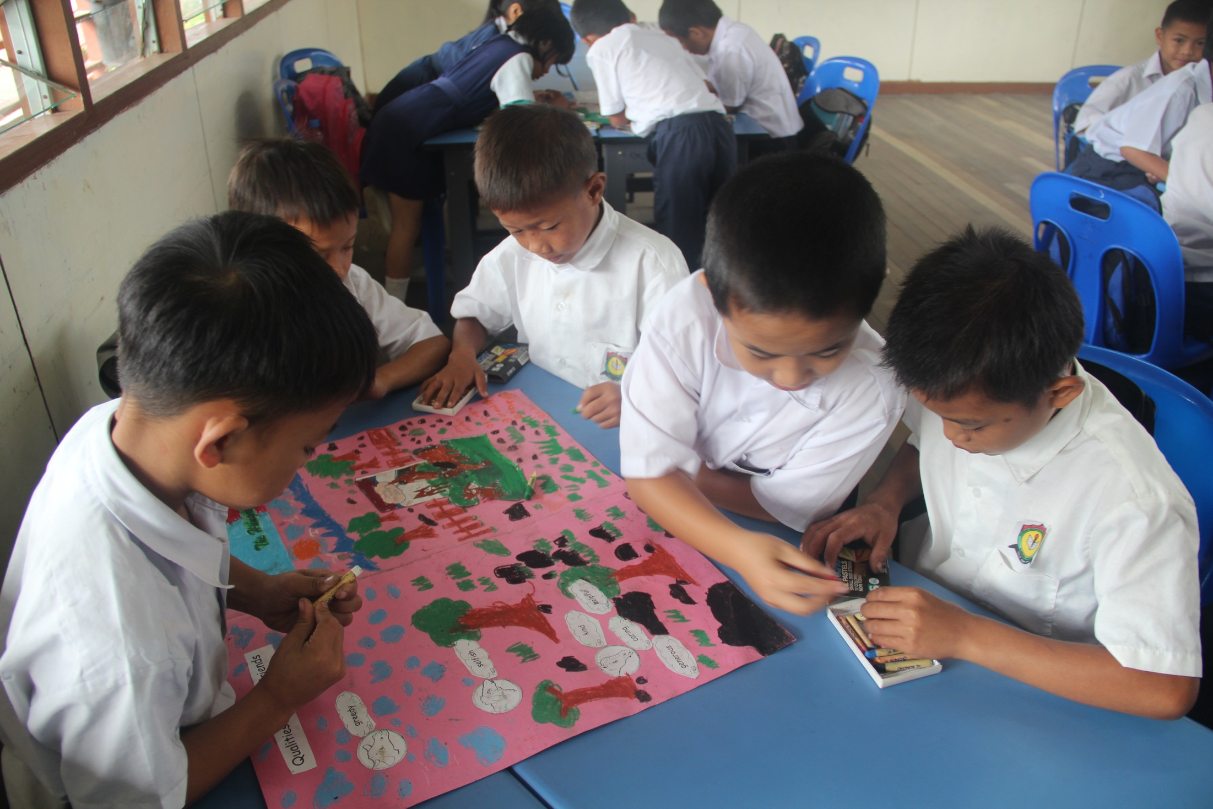

Slide 14
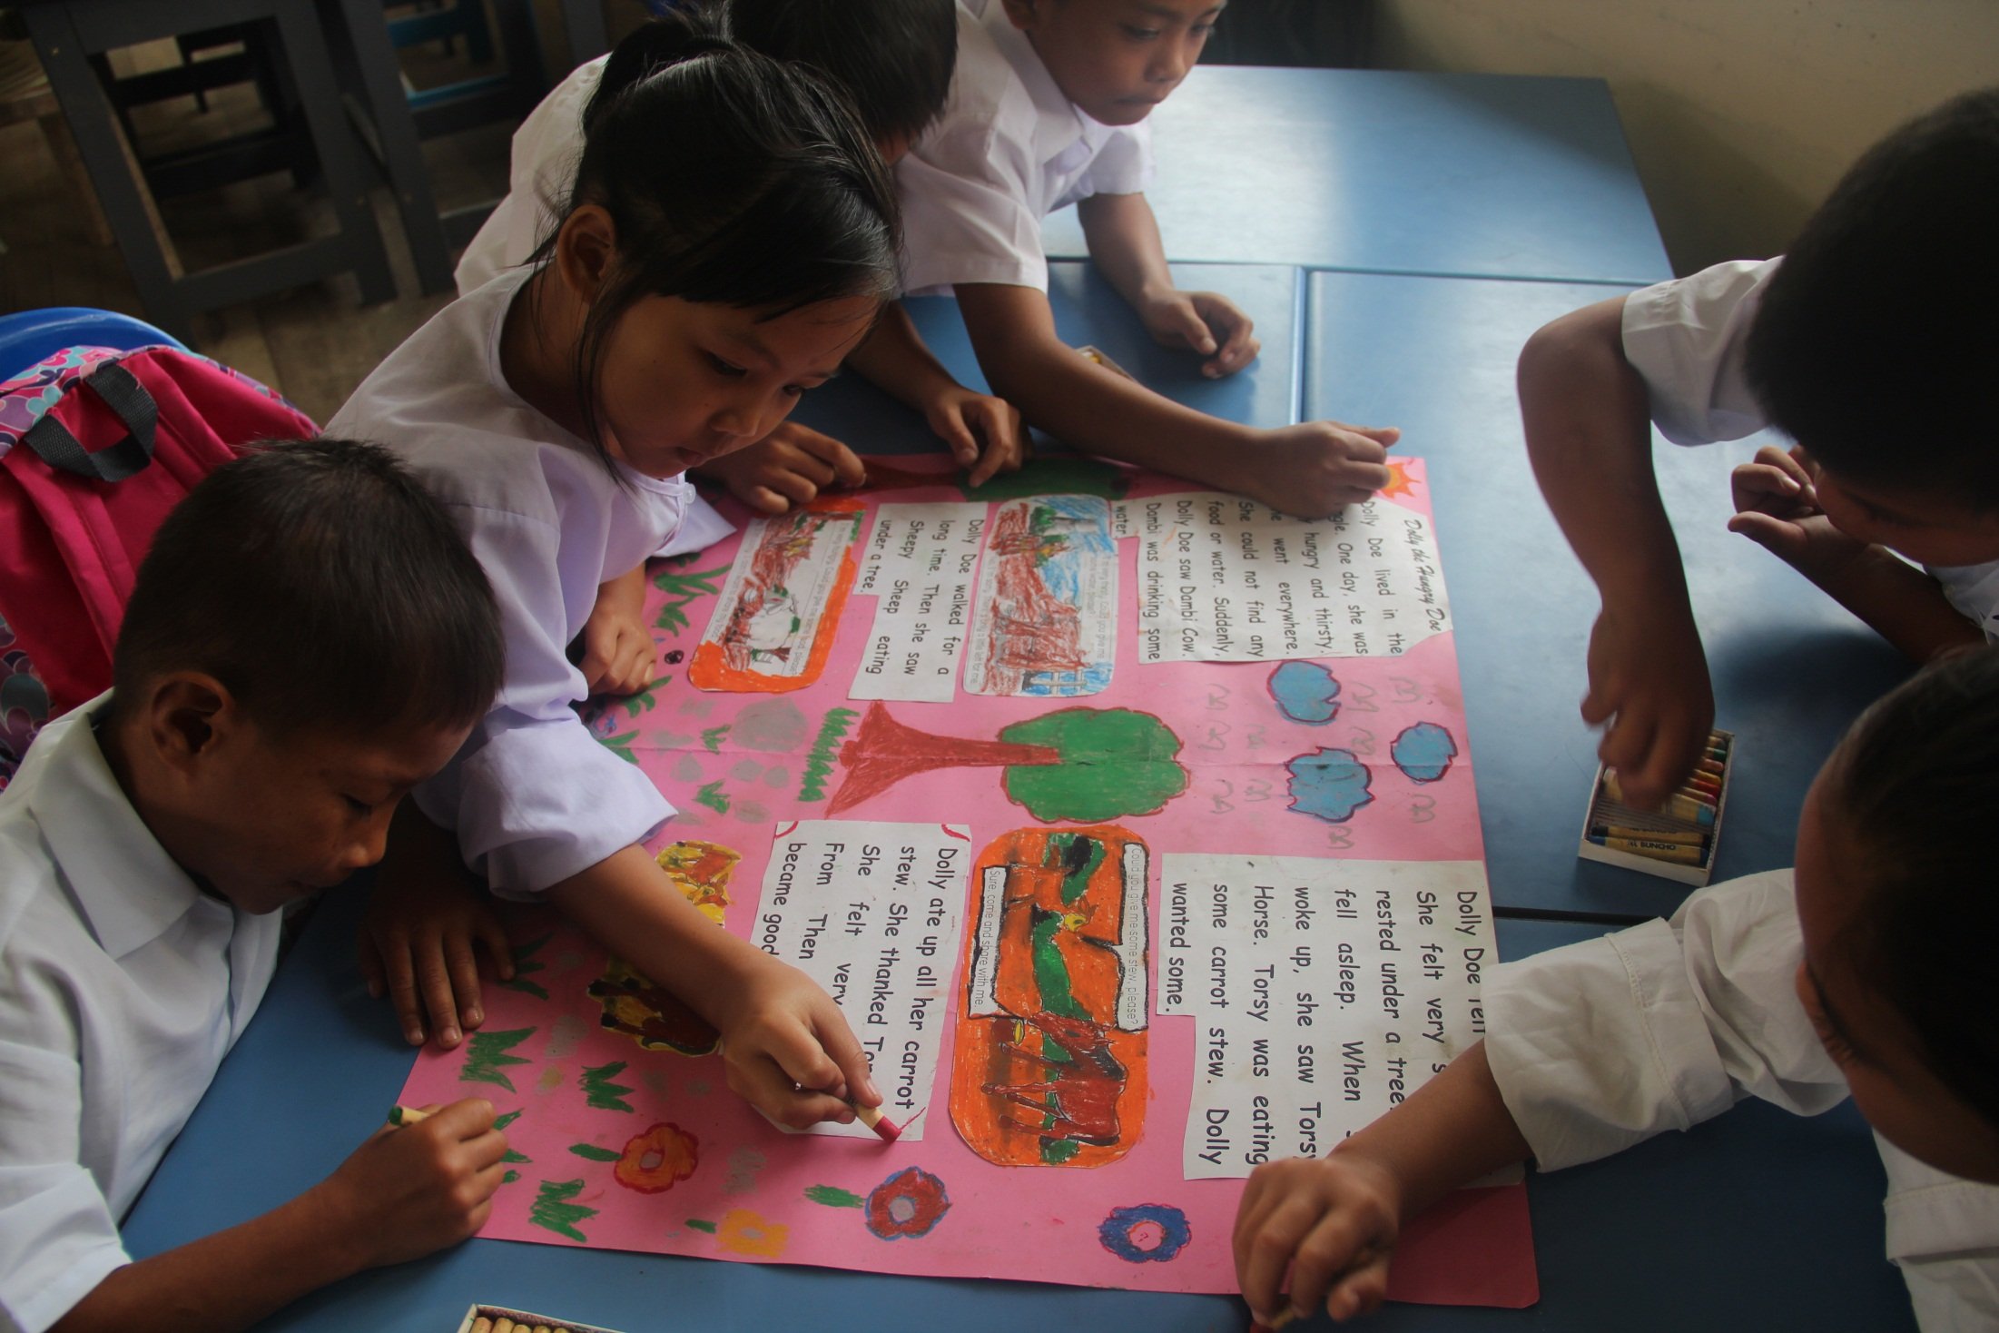

Slide 15
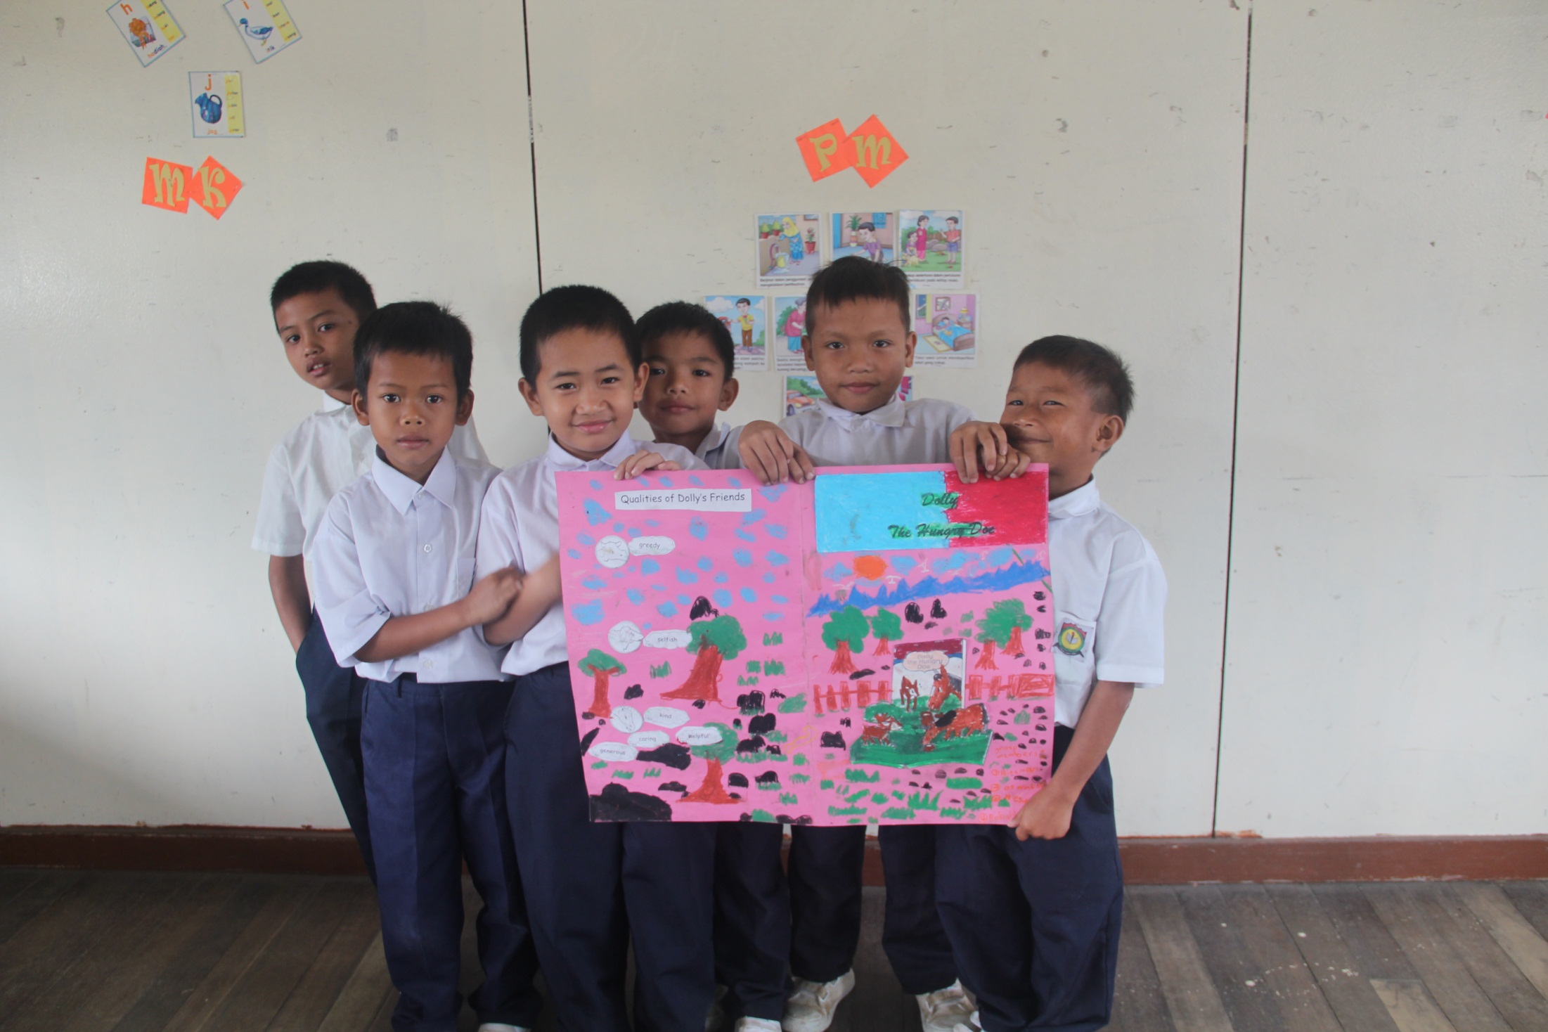

Slide 16
By selecting a Task –Based Learning approach,
I also incorporated :
Pairwork
Group work
Peer Teaching and differentiated Learning

Slide 17
“ If we value independence, if we are disturbed by the growing conformity of knowledge, of values, of attitudes, which our present system induces, then we may wish to set up conditions of learning which make for uniqueness, for self-direction, and for self-initiated learning.”
Carl Rogers

Slide 18
What have I learnt from this class?
What have they given me?
Have they made me a better teacher?
Notes:
through

Slide 19
THANK YOU
FOR
LISTENING
Notes:
through

