Slide 1
SHARED READING
BY MAS ADIBA BINTI MAHUSAIN
SK POYUT, BARAM
SARAWAK

Slide 2
In pairs, discuss the following questions.
Do you think your children enjoy reading? Why/why not?
Are they able to read well?
Do you find reading a challenge in your classroom?
Do you use other materials other than KSSR text books to help with reading?
Have you tried shared reading in your class?

Slide 3
What is shared reading?

Slide 4
WHAT IS SHARED READING?
Shared reading is a strategy which involves the joint participation of teachers and children around a shared text.
Often the text will be a ‘big book’ - which the group read together in a variety of different ways.
The teacher is able to demonstrate reading with the class and can focus upon particular aspects of the process or strategies of reading.
In addition, the teacher can highlight the use of particular types of words and sentences that contribute to the meaning of the text.

Slide 5
How to use a shared reader?

Slide 6
How to use a shared reader?
The teacher introduces the book. The teacher asks questions about the title, pictures, characters and asks them to predict what the story about. The teacher draws on the children’s existing knowledge of the topic.
The teacher reads the book multiple times, over several days. During this time, the children are actively involved in the reading.
The first reading is for enjoyment. The teacher reads the story aloud using voice, gesture and action to bring the story alive.

Slide 7
The second focus is on building and extending comprehension of the story.
A third might focus attention on the interesting language and vocabulary.
You could also focus on phonic knowledge and phonemic awareness or flow and fluency.
Afterwards, You can use the text to do follow on activities focusing on other skills. Activities could include role play, retelling the story, drawing the characters, recreating an alternative ending or other language arts activities.

Slide 8
research

Slide 9
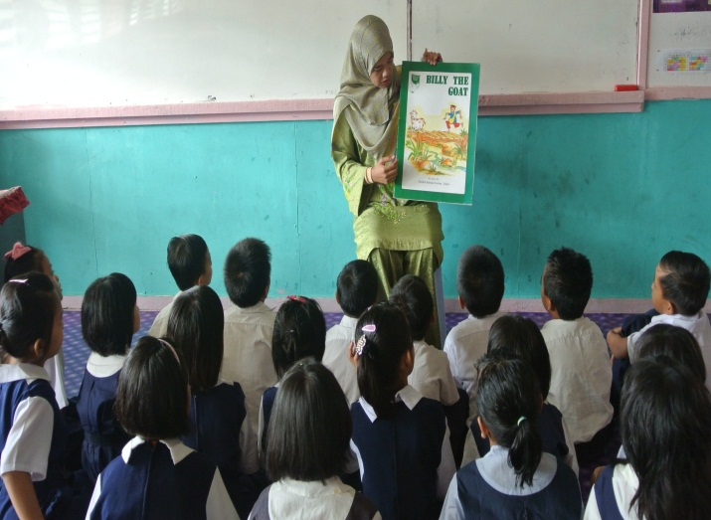
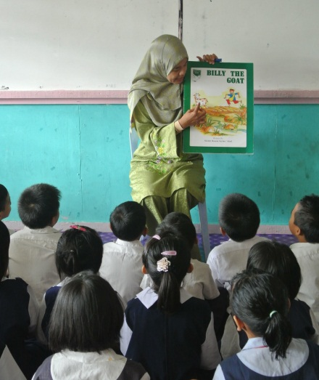
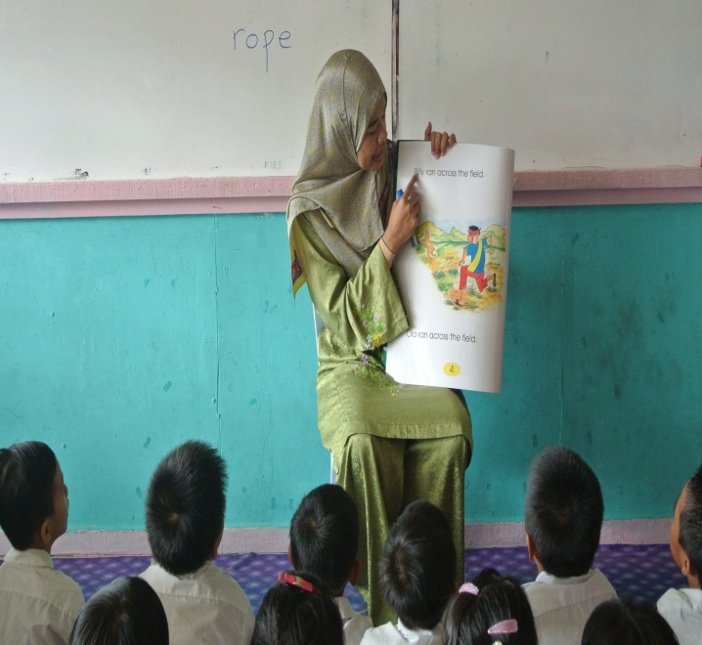
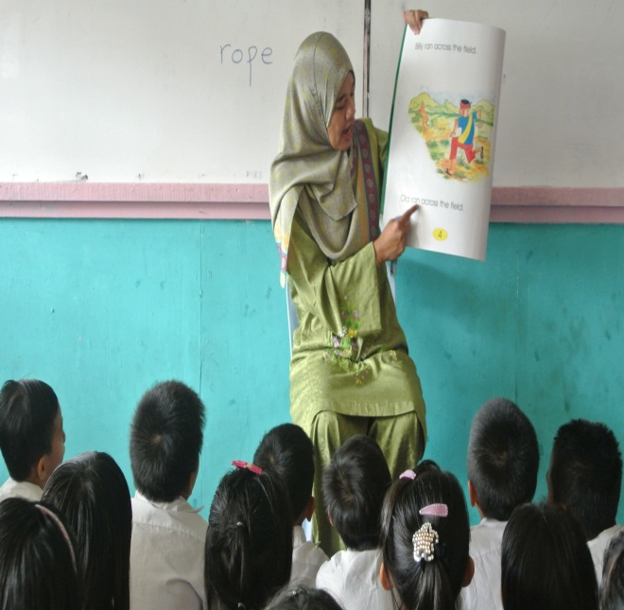
RESEARCH - 1

Slide 10
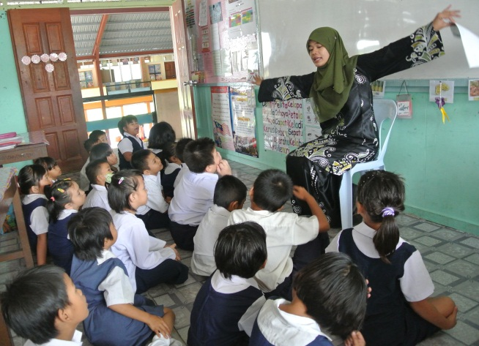
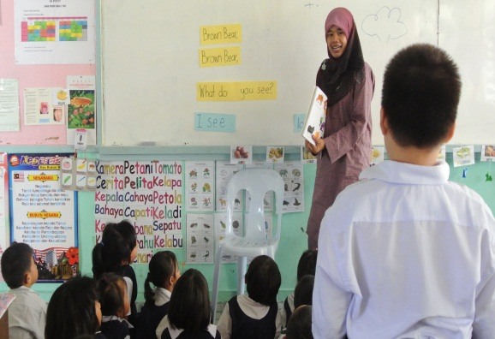
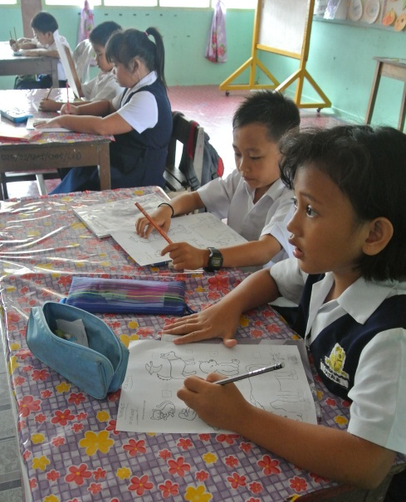
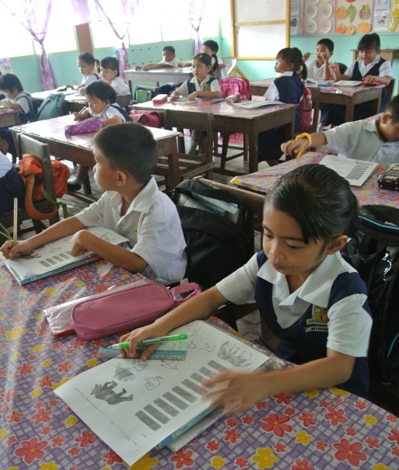
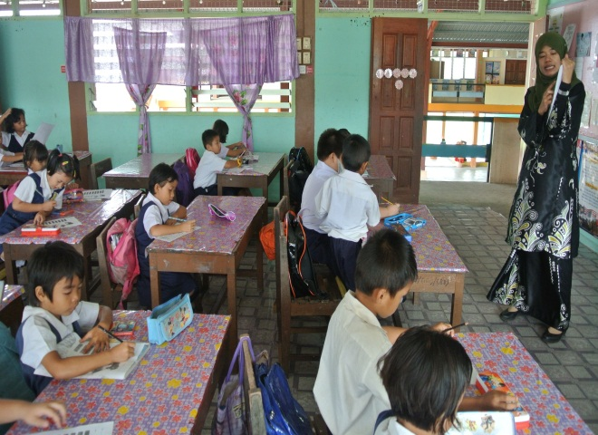
RESEARCH - 2

Slide 11
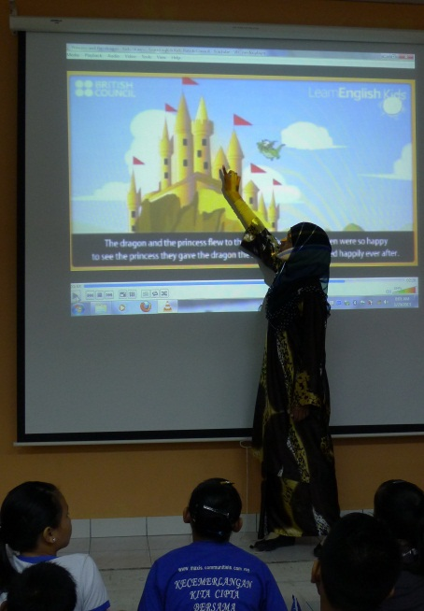
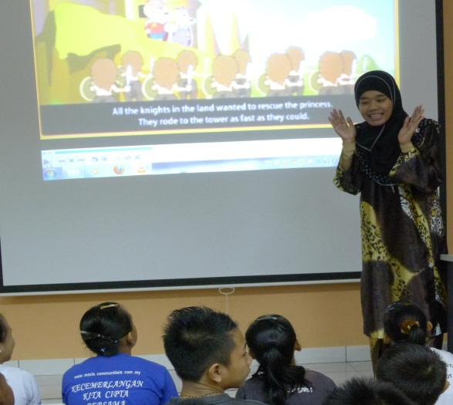
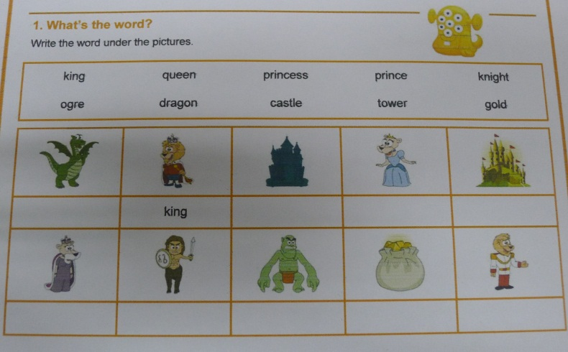
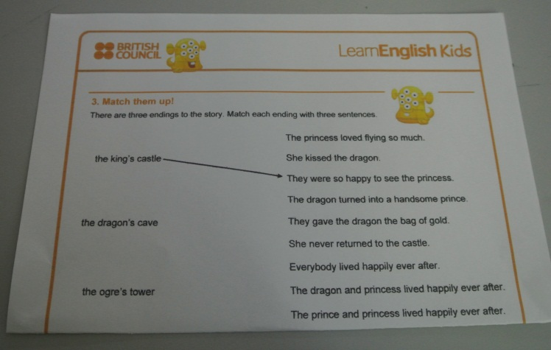
RESEARCH - 3

Slide 12
advantages

Slide 13
ADVANTAGES
There are many advantages to use shared reading.
With your partner, can you think of advantages of shared reading?

Slide 14
ADVANTAGES
Teachers can demonstrate the skills of reading.
Children can enjoy listening and responding to a story.
Awareness of the functions of print, familiarity with language patterns, and word-recognition skills grow as children interact several times with the same selection.
Students are able to read the story confidently.
Increase in spoken language.

Slide 15
CHALLENGES

Slide 16
CHALLENGES
Reading the story naturally.
Finding appropriate materials.

Slide 17
ACTIVITY

Slide 18
THANK YOU☺

