Slide 1
Eltdp symposium Teaching Pupils With Special Needs Effectively in Mainstream Classes
ROSNAH SAHILAN
SK TAMAN TAWAU
TAWAU, SABAH

Slide 2
PROBLEMS???
Every class has challenging pupils. They are being put in mainstream classes where teachers aren’t equipped to deal with them
In the past 2 years I’ve had several boys with high energy, low concentration skills similar to ADD and boy with autism
I decided to research how to handle them and integrate them into lessons so they can also learn effectively, without being too disruptive. In this session I will share my research and the processes undertaken, as well as having attending participants discuss and plan what they can do to make a difference with pupils with special needs

Slide 3
Pupil’s background
Attention Deficit Disorder (ADD)
Fail to pay close attention to details or making careless mistakes when doing school-work or other activities
Trouble to keep attention or focused during play or tasks
Not listening when spoken to (often being accused of "daydreaming")
Fail to follow instructions or finish tasks
Avoid tasks that require a high amount of mental effort and organization, such as school projects
Forgetfulness. Frequently losing items required to facilitate tasks or activities, such as school supplies
Easily distracted especially by friends
Inability to begin an activity @ delaying

Slide 4
Pupil’s background
Autism
Autism is a "spectrum disorder," which means it is possible to be severely autistic or just mildly autistic
Difficulty communicating with others
Difficulty making friends
Difficulty making sense of the world
Resistance to change in routine
Obsessive behaviours

Slide 5
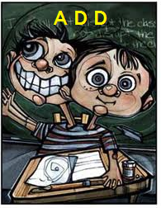
Your perceptions???
“ What the problems will be if they are accepted in mainstream classes ?”

Slide 6
public perceptions
They are very naughty
They are dangerous to others
They should not go to the mainstream school
They will be bullied by others
They will distract the lesson in school
They are not safe in school

Slide 7
As a teacher what should we do??
Be positive
Don’t judge @ label your pupils instantly
Get to know them
Talk to them and their parents more often
Do the Action Research in the classroom
Don’t give up easily
Discuss with your friends or mentors
To get more ideas @ share their experiences
Keep up in your minds that “God create us always with “something special” accept them as what they are

Slide 8
Action research in the classroom
PLAN
DO
LOOK/ REVIEW
THINK

Slide 9
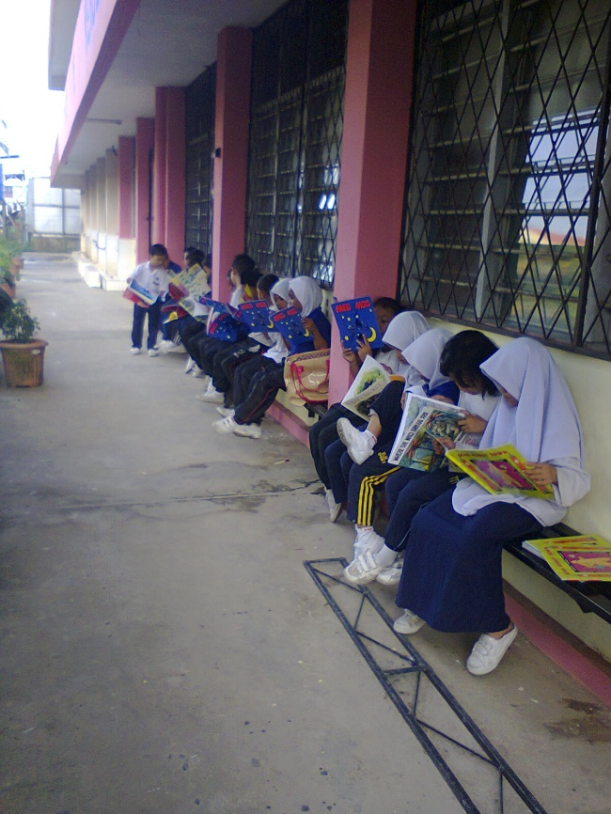
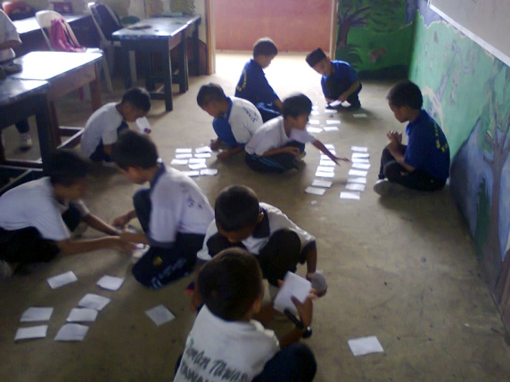
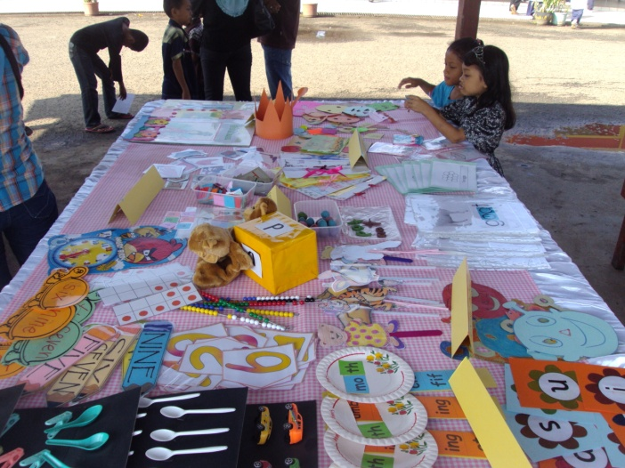
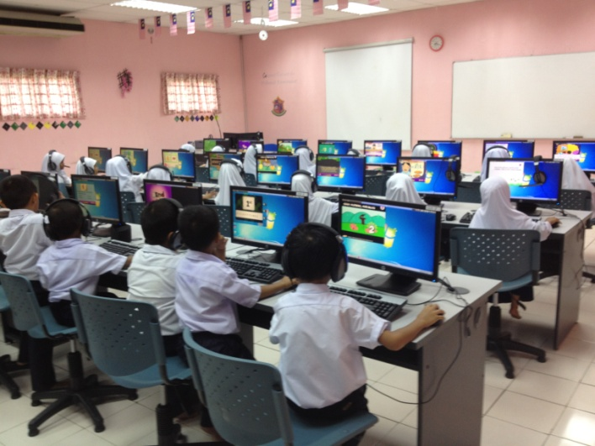
Activities in school

Slide 10
Types of activities
YES | NO
Individual (for autism) / Small group (2 -3 pupils for ADD) task or activity | Large group task
Talk with the existence of visual aids such as puppets, pictures etc. | Talks only or using unattractive pictures.
Using interactive ICT tools | ICT presentation only

Slide 11
Tips for T&L session
Let them sit between the most quiet person & well behaved pupils in class
Near to teacher’s table. Try to keep them away from windows or door
More fun activities like language games in class but for them they can play the game individually @ with teacher
Different pupils have different approach @ types of activities. There is where the action research started
Use more visual & colourful (but not too bright) teaching aids
Use simple & concrete language when you give an instruction
Try not to bother them but at the same time you pay attention to them. They don’t like to be the centre of attention

Slide 12
conclusion
As teachers we should think differently but act positively
Be patient to manage them
Awareness and understanding are the key of success
Never blame teachers. All school staff need training in autism and ADD
There is no absolute finding that can suit all the special needs pupils. Different pupil has different behaviours and characteristics

Slide 14
Discuss in your group
Do you face the same problems? If not maybe others?
How does it affect your classes?
What can you do to make your T&L effective?

