Slide 1
THE ‘SOUND’ FORMULA FOR LITERACY: A TEACHER’S REFLECTION AND DISCOVERY
ELTDP SYMPOSIUM 2013
HANIZA KHAMIS
SK KG SELAMAT, KUNAK, SABAH

Slide 2
My Reflections
During the KBSR era, I taught reading to my pupils using the Whole Word method.
Despite using many different types of activities, I noticed that my pupils progress were very slow.
When KSSR came in 2011, I discovered Phonics.
I tried the approach with my Year 1 pupils and I could see some very significant differences.
My pupils were able to read at a much faster rate.
That made me want to learn more about Phonics and try to discover how it can help my pupils.

Slide 3
My Research Questions
What makes reading difficult for my pupils?
What can I do to help them overcome the difficulties?
What is the best technique / approach to help my pupils?

Slide 4
My Discovery
My pupils had difficulties decoding written words because they had trouble associating letters with sounds.
Whole Word method requires the pupils to read by memorizing the spelling of a whole word – my pupils cannot do that.
In order to help my pupils, I need to find the right ‘formula’ that would help the pupils to sound letters individually and then put them together to form a word.

Slide 5
“Children must be taught how to think, not what to think”
-Margaret Mead

Slide 6
How I Discover the ‘Sound’ Formula for Literacy
KSSR introduces Phonics to me.
At first, I had my doubt.
After trying out Phonics in my Year 1 class, I discovered that my pupils were able to read at a much faster rate than before.
Phonics help my pupils to learn the individual sounds of letters.
Phonics help my pupils to decode words better.
By focusing on the blending and segmenting activities, I was able to help my pupils to be better readers.

Slide 7
Phonics: What is it all about?
Phonics
Letter sound
Blending
Segmenting
Pronunciation
Different sound system

Slide 8
Phoneme- a unit of sound
Grapheme- a letter or group of letters representing a sound.
Segmenting- dividing words into phonemes.
Blending- combining individual phonemes to form a word.

Slide 9
Phonics – The ‘Sound’ Formula
What is phonics?
Phonics is a method of teaching beginners to read and pronounce words by learning to associate letters or letter groups with the sounds they represent.

Slide 10
My Classroom Research
My pupils had trouble decoding words
Think
Plan
Do / review
Look

Slide 11
My Action Plan
Conducting Internet and book research on Phonics.
Conducting observations on the pupils’ reading habit.
Trying out different types of activities related to blending and segmenting words.
Conducting ongoing assessment on the pupils’ reading progress.
Recording my lesson activities and writing my personal reflections.

Slide 12
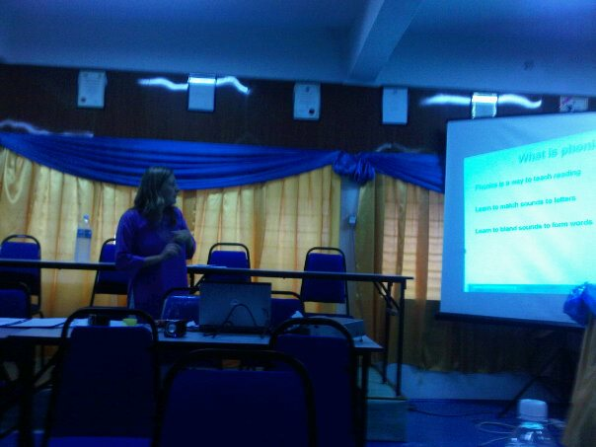
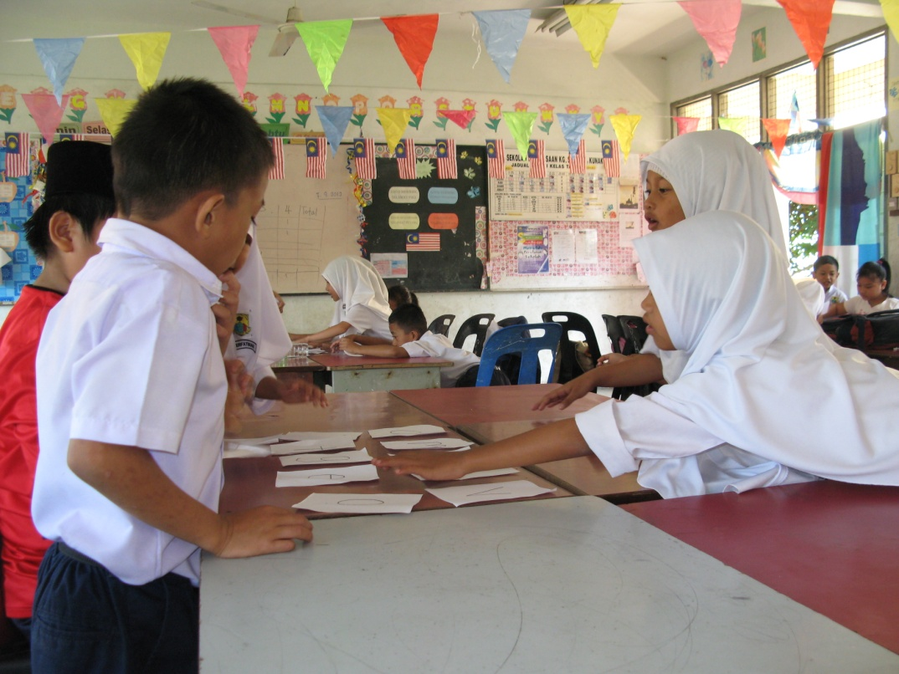
Discussions with my ELTDP mentor.
Trying out various Phonics activities with my pupils.

Slide 13
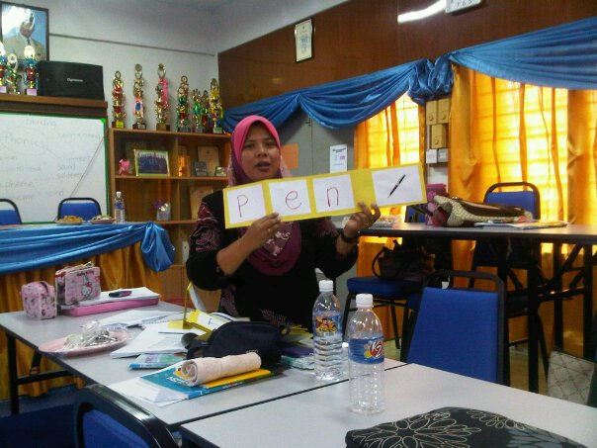
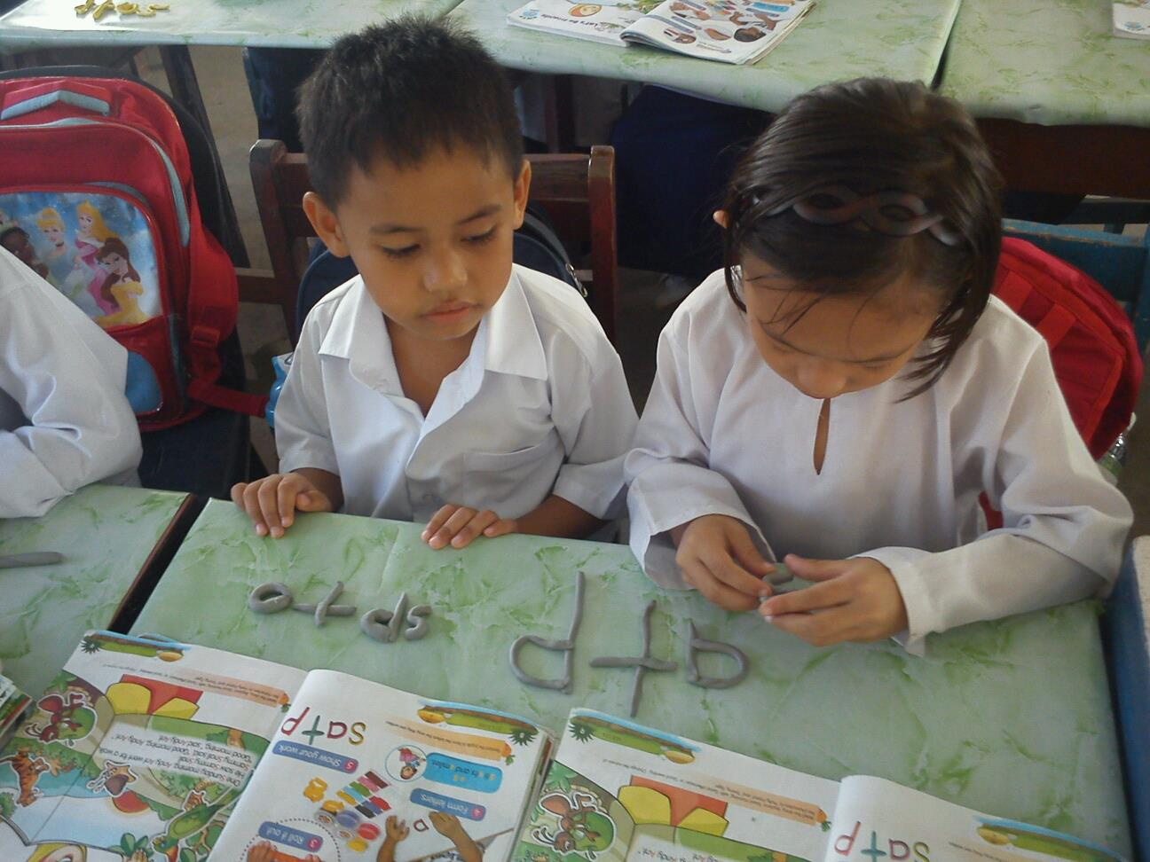
Sharing ideas on Phonics activities with other teachers.
Classroom assessments and observations.

Slide 14
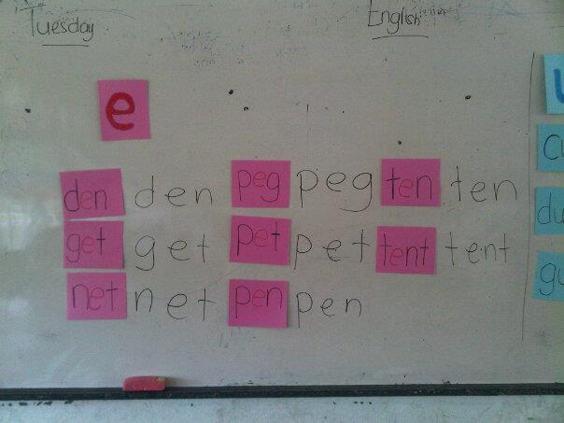
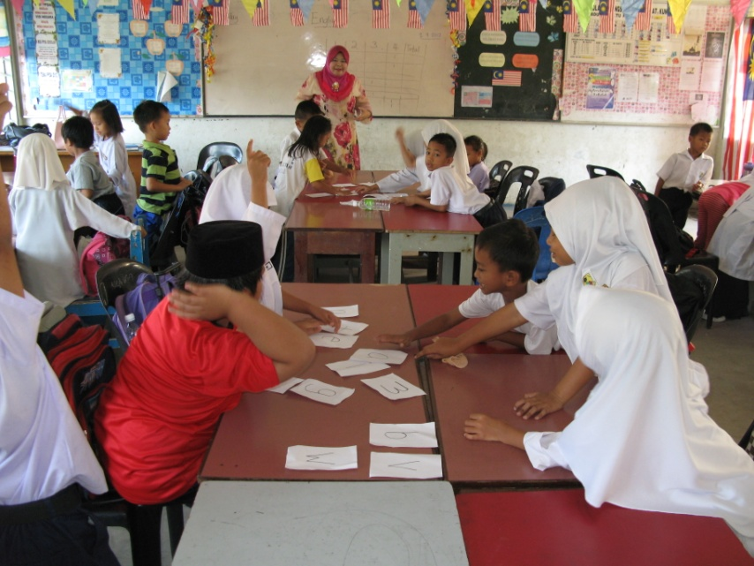
Discovering a system of teaching reading through Phonics.
Experimenting on different types of activities.

Slide 15
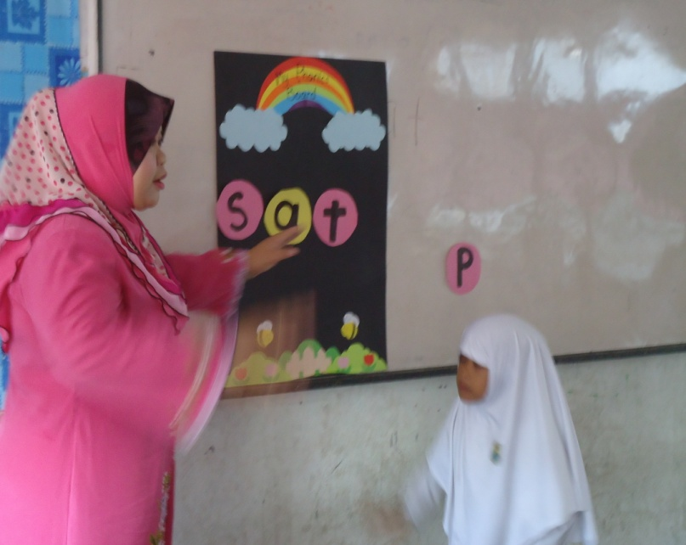
My Phonics Board

Slide 16
My Findings
Before Phonics | After Phonics
My pupils had trouble associating letters with sounds. | My pupils could recognise and identify the individual sounds of letters.
My pupils had trouble decoding words. | My pupils can segment and blend words easily.
My pupils’ reading progress was very slow. | My pupils were able to read at a much faster rate.
Reading is a boring and uninteresting chore for my pupils. | My pupils were more engaged in the reading process – they enjoyed the segmenting and blending activities.
Difficult and confusing to teach reading. | Much better and more understand.

Slide 17
What I learnt
Teaching reading through Phonics should be done systematically.
Regular practice using Phonics can help children to be better readers.
Phonics should not be taught alphabetically.
Teacher can expand Phonics activities by conducting some Phonics-related activities outside the classroom.
Phonics is fun! – There are various interesting Phonics activities that can help teachers to teach blending and segmenting to children.

Slide 18
Post-Research Reflection
As a teacher, I found that Phonics enriches my experience in teaching reading.
Phonics enhances my creativity and motivates me to explore more interesting teaching ideas and techniques.
I learnt that the best way to teach is by getting back to basics.
Teaching sound-letter association is all about teaching the basic skills of reading.
Phonics has helped me be more open to new ideas and methods.

Slide 19
Useful links and resources.
http://www.mrthorne. com
http://www.oxfordowl.co.uk
http://learnenglishkids.britishcouncil.org/
http://jollylearning.co.uk/
http://jollylearning.co.uk/2010/11/03/jolly-phonics-actions/(teaching sounds with actions)
Books/articles
Letters and Sounds

Slide 20
Let’s try it out…

Slide 21
“Do not train a child to learn by force or harshness; but direct them to it by what amuses their minds, so that you may be better able to discover with accuracy the peculiar bent of the genius of each.” -Plato

Slide 22
Book and articles

