Slide 1
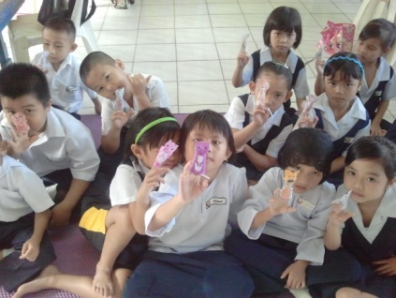
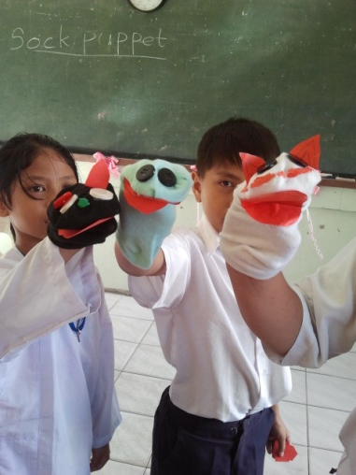
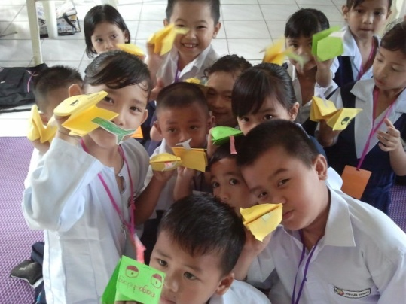
2013 English Language Teacher Development Project Symposium
“Using Puppets to Increase Pupils’ Confidence in the Language Classroom”
By
Dayana Nayan
Lis Da Rocha

Slide 2
What can you expect from this workshop?
Theoretical background
Personal experience in using puppets:
Why I use puppet?
How I use puppet?
What changes do I start to see in my classroom?
Q & A session
Hands-on activity: Making puppets
Activity using puppet
Quick Survey

Slide 3
Theoretical background: Puppets increase the students’ confidence to speak English
“ L2 is a complex task that is susceptible to human anxiety, which is associated with feelings of uneasiness, frustration, self doubt and apprehension”
(Shumin, 1997).
Therefore:
“When a child speaks through the puppet, it is not the child who is perceived as making errors but the puppet, and children find this liberating”
(Ordeniz, 2000).
“ Puppetry offers children the ultimate disguise”
(O’ hare, 2005).

Slide 4
Why I use puppets in my English lessons: Issues among the students

Slide 5
Situation 1:

Slide 6
Students are afraid of making mistakes/don’t want to embarrass themselves
Students have limited vocabulary to speak English
Students social background:
Exposure towards English language is limited within school only.
English is not being used outside the school- eg; at home
Students hesitate to use English when communicating

Slide 7
Situation 2

Slide 8
Need a platform/medium for natural interaction to take place
But, show a lack of confidence to express themselves using English
Students are fairly good at reading and writing skills

Slide 9
How I use puppets to increase the students’ confidence in speaking English during the lessons

Slide 10
A short video on how i use puppets

Slide 11
1. Introducing puppets as the new members of the class.
2. Teaching basic interpersonal language skills through puppets.

Slide 12
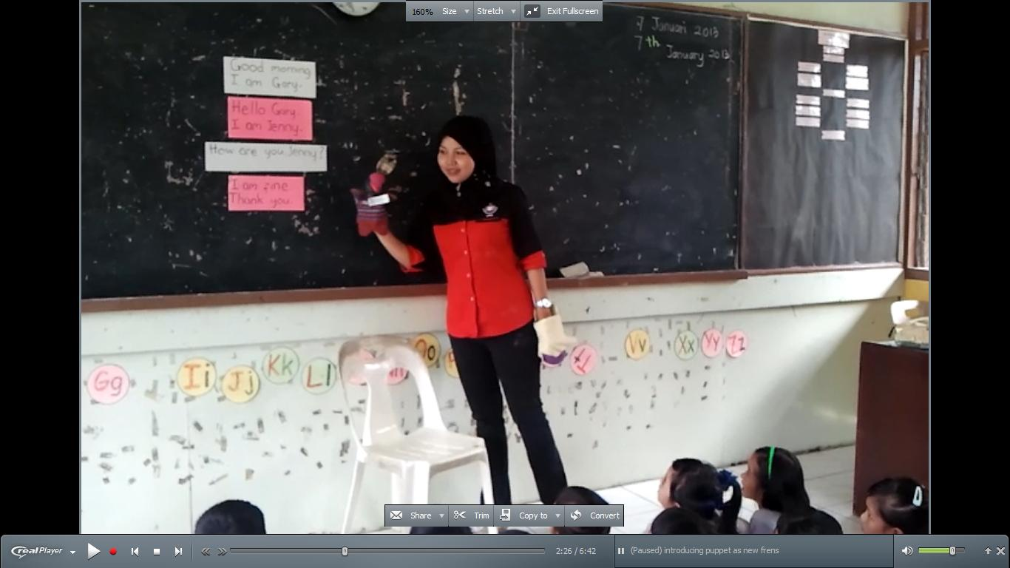
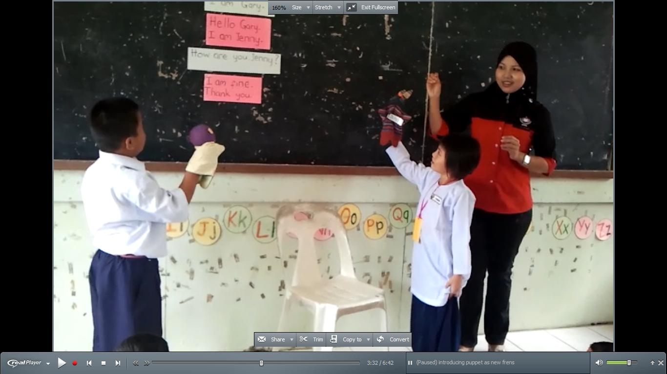

Slide 13
3. Let the students create the identity of their own puppet.

Slide 14
4. Let the students interact with each other through their puppets.

Slide 15
5. Involve the puppets in various language activities such as singing, playing language games and group activities.

Slide 16
What changes do I start to see in my students

Slide 17
1. More participation during Speaking and Listening activities. Students are highly engaged.
2. Learner autonomy increases .
3. The puppets encourage the students not to give up easily and switch to mother tongue when communicating in English.

Slide 18
4. Students become more relaxed and less self-conscious when speaking English through puppets.
5. Students definitely have more fun during English lessons.

Slide 19
How to make simple puppet
Hand puppet: Lion puppet
Finger puppet: Dog puppet

Slide 20
Activity
Introduce puppets to each other.
Students sit in pairs. Assign different emotions to the students. Eg: Happy, angry, sad, shy. Let the students talk in those emotions. Other students guess the emotions.

Slide 21
Pictures

